Slide 1



Análisis Toxicología SML MG Dennis V4
View in Power BI
Last data refresh:
26/10/2023 12:58:33 UTC
Downloaded at:
26/10/2023 13:06:45 UTC

Slide 2
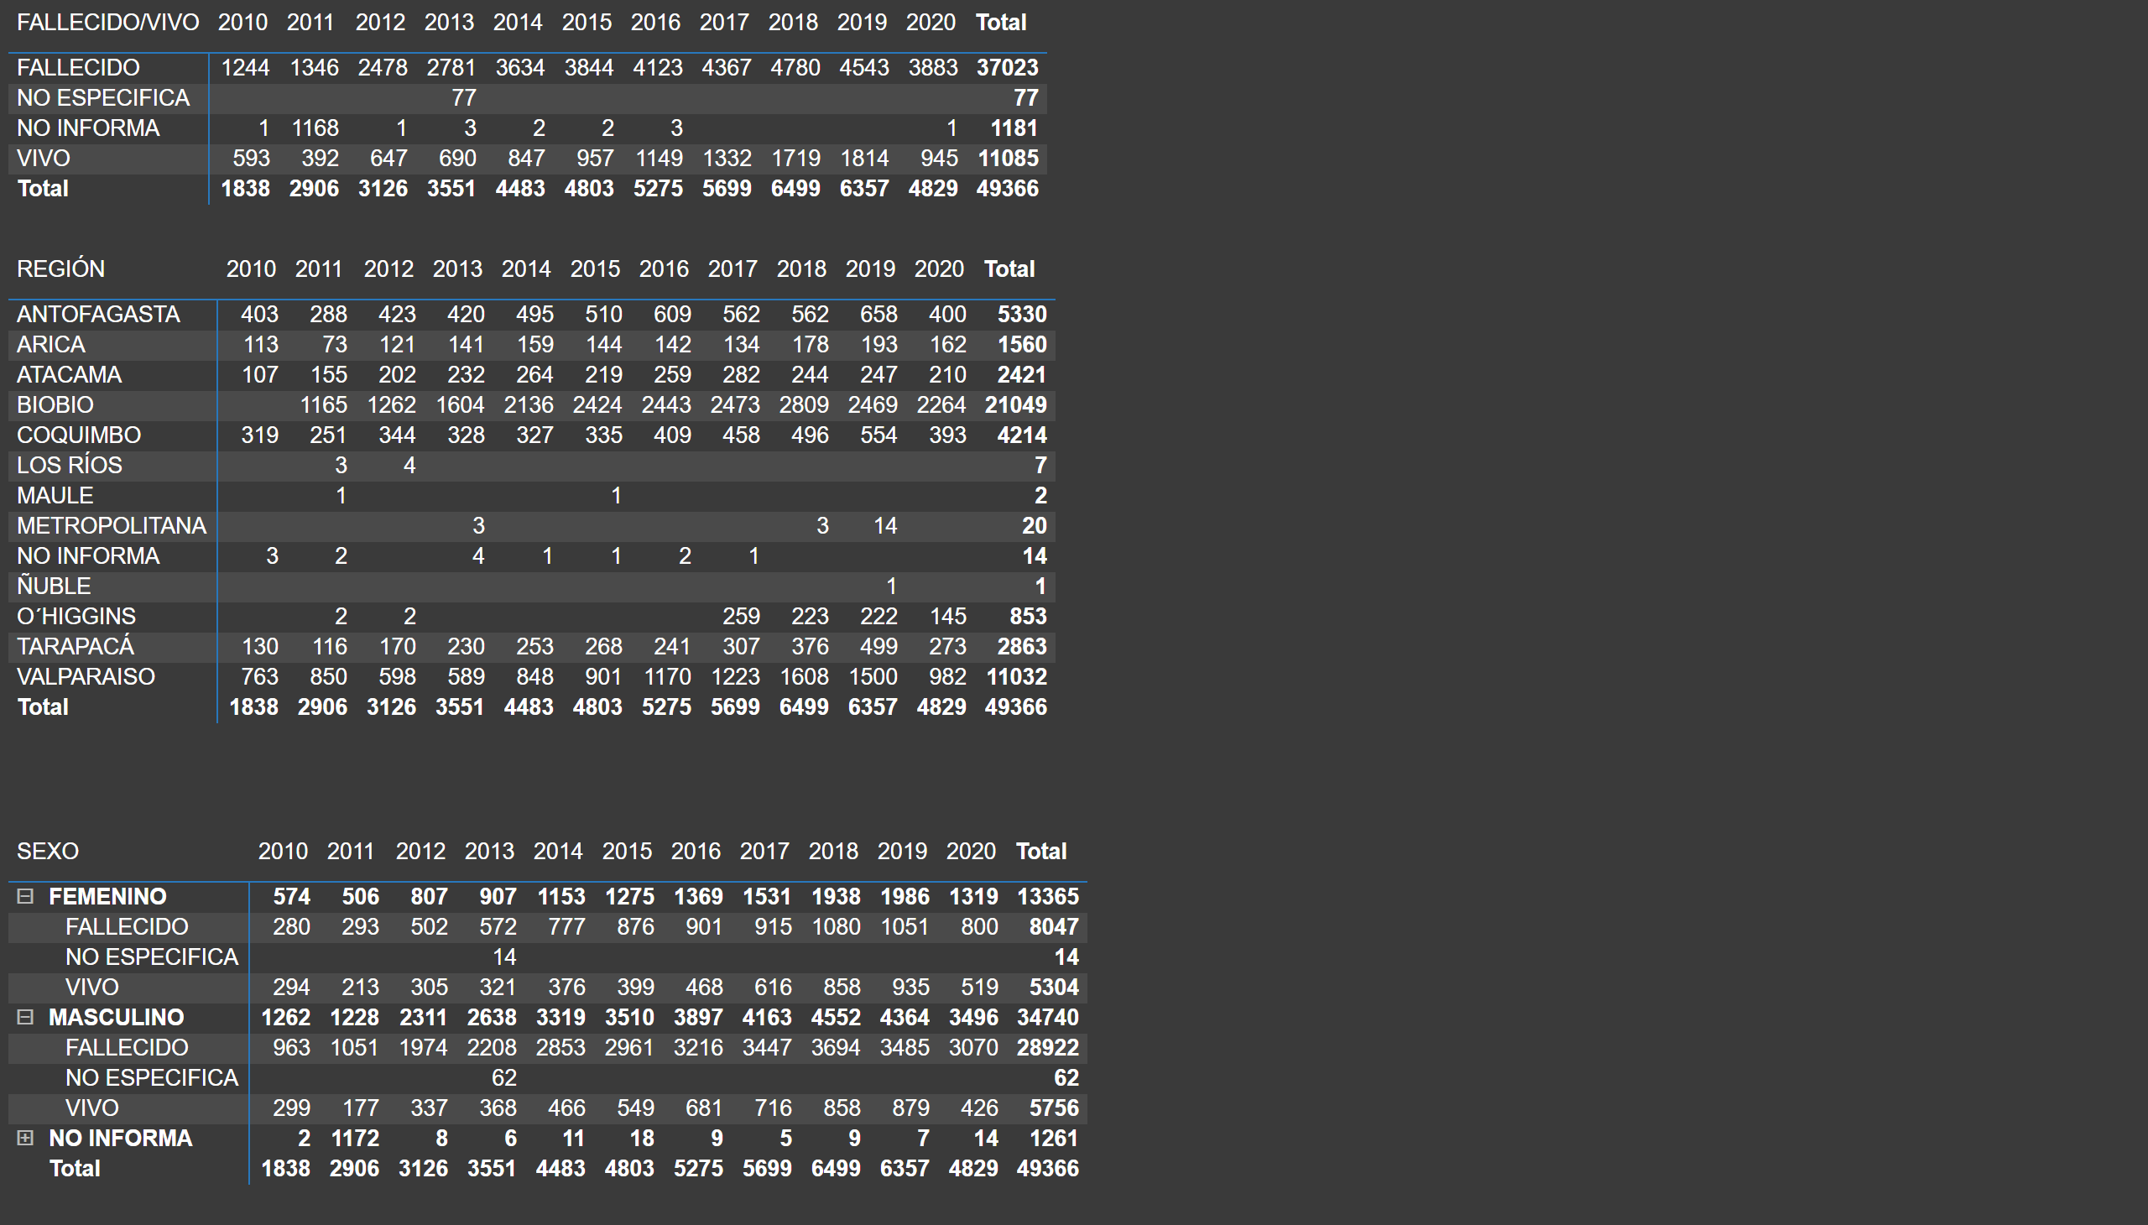
Tablas (!)
Notes:
pivotTable
No alt text provided
pivotTable
No alt text provided
pivotTable
No alt text provided

Slide 3
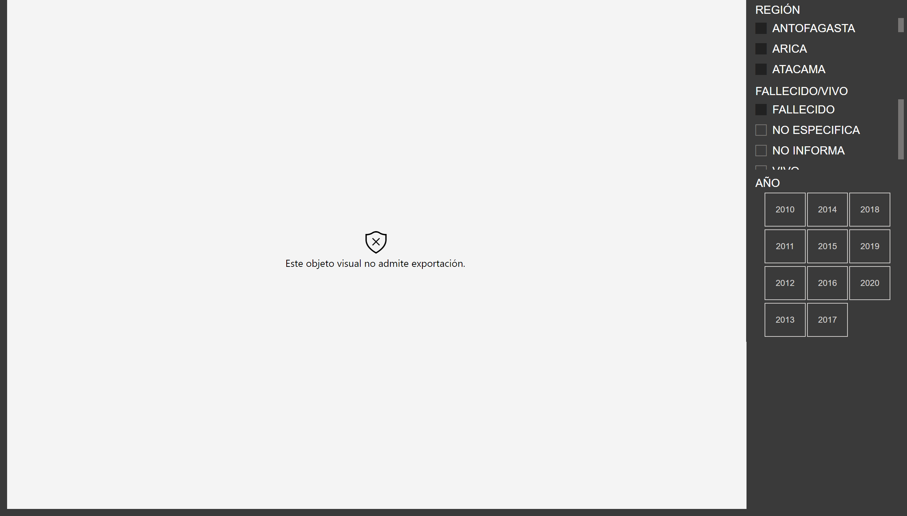
Temporal Fallecidos x Región (!)
Notes:
wishyoulizationbarchartrace
No alt text provided
slicer
No alt text provided
slicer
No alt text provided
slicer
No alt text provided

Slide 4
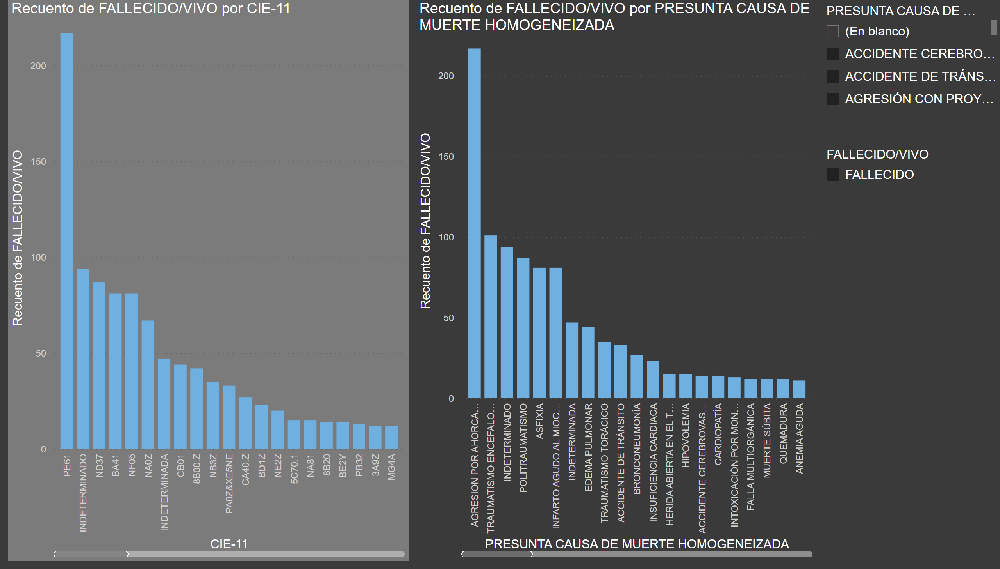
Exploratorio Causa Muerte H y Código (!)
Notes:
clusteredColumnChart
No alt text provided
clusteredColumnChart
No alt text provided
slicer
No alt text provided
slicer
No alt text provided

Slide 5
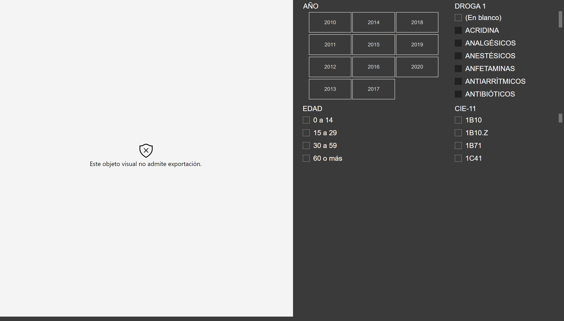
Trayectoria Temporal x código (!)
Notes:
wishyoulizationbarchartrace
No alt text provided
slicer
No alt text provided
slicer
No alt text provided
slicer
No alt text provided
slicer
No alt text provided

Slide 6
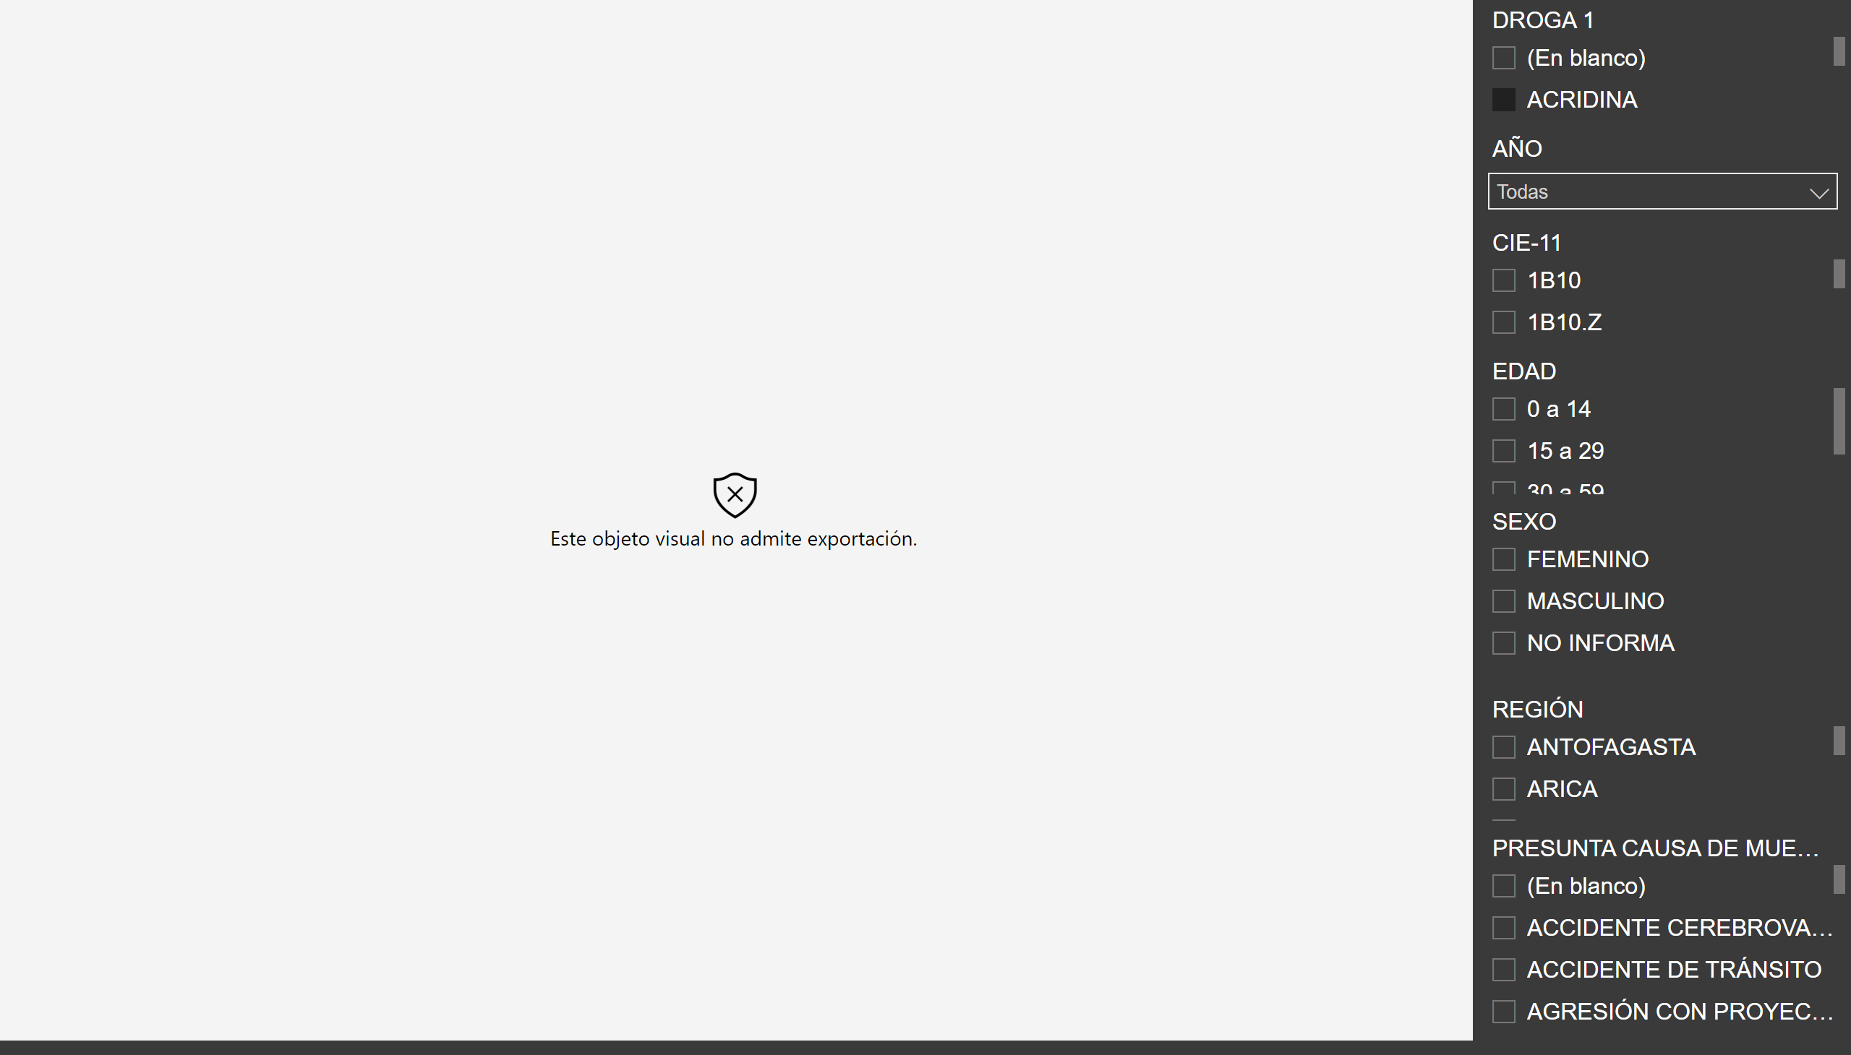
D1
Notes:
wishyoulizationbarchartrace
No alt text provided
slicer
No alt text provided
slicer
No alt text provided
slicer
No alt text provided
slicer
No alt text provided
slicer
No alt text provided
slicer
No alt text provided
slicer
No alt text provided

Slide 7
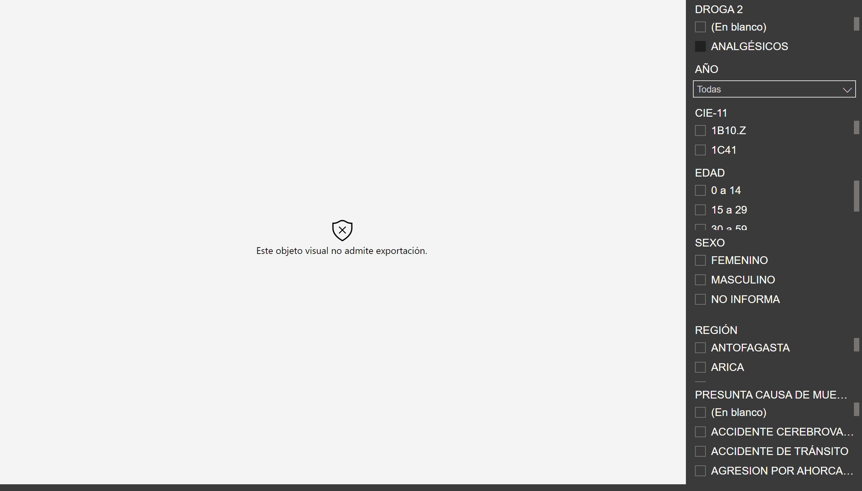
D2
Notes:
wishyoulizationbarchartrace
No alt text provided
slicer
No alt text provided
slicer
No alt text provided
slicer
No alt text provided
slicer
No alt text provided
slicer
No alt text provided
slicer
No alt text provided
slicer
No alt text provided

Slide 8
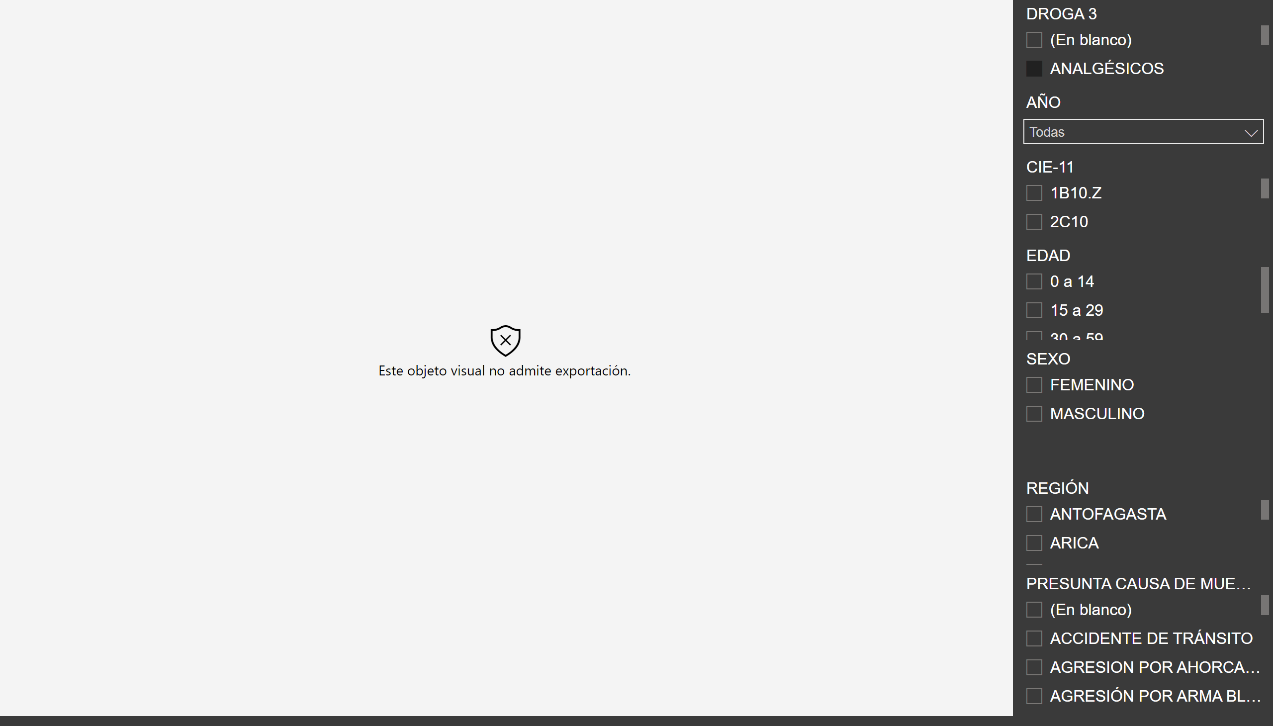
D3
Notes:
wishyoulizationbarchartrace
No alt text provided
slicer
No alt text provided
slicer
No alt text provided
slicer
No alt text provided
slicer
No alt text provided
slicer
No alt text provided
slicer
No alt text provided
slicer
No alt text provided

Slide 9
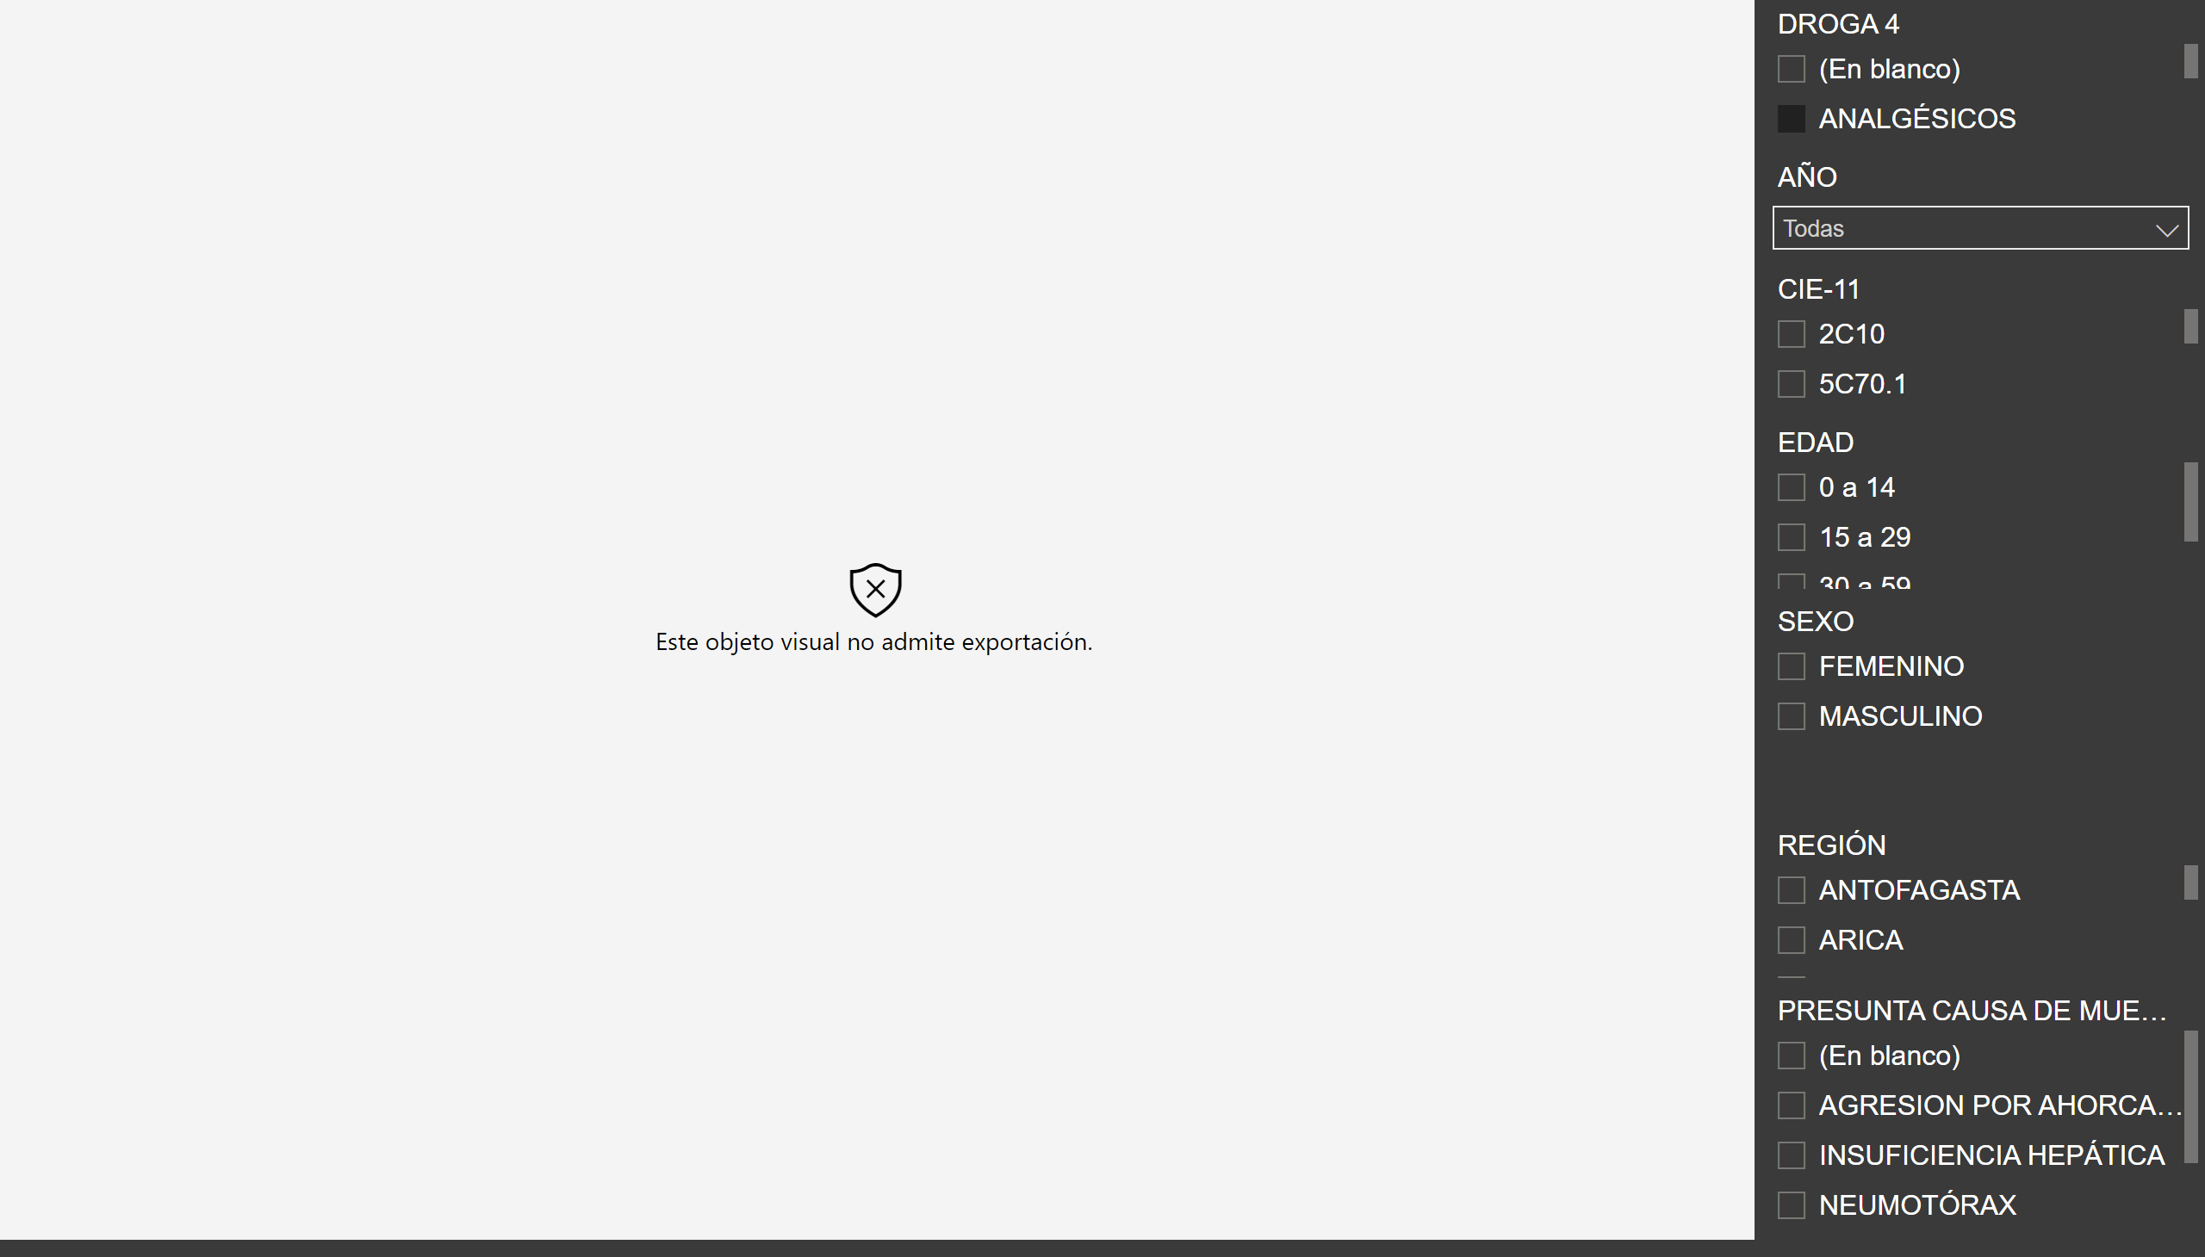
D4
Notes:
wishyoulizationbarchartrace
No alt text provided
slicer
No alt text provided
slicer
No alt text provided
slicer
No alt text provided
slicer
No alt text provided
slicer
No alt text provided
slicer
No alt text provided
slicer
No alt text provided

Slide 10
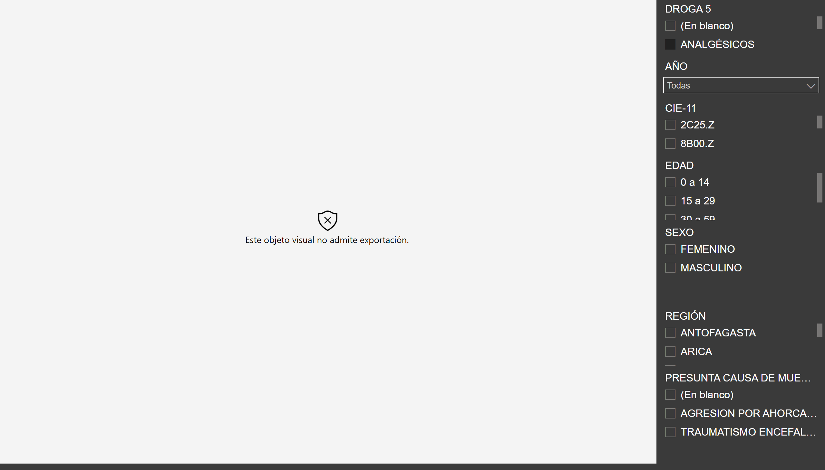
D5
Notes:
wishyoulizationbarchartrace
No alt text provided
slicer
No alt text provided
slicer
No alt text provided
slicer
No alt text provided
slicer
No alt text provided
slicer
No alt text provided
slicer
No alt text provided
slicer
No alt text provided

Slide 11
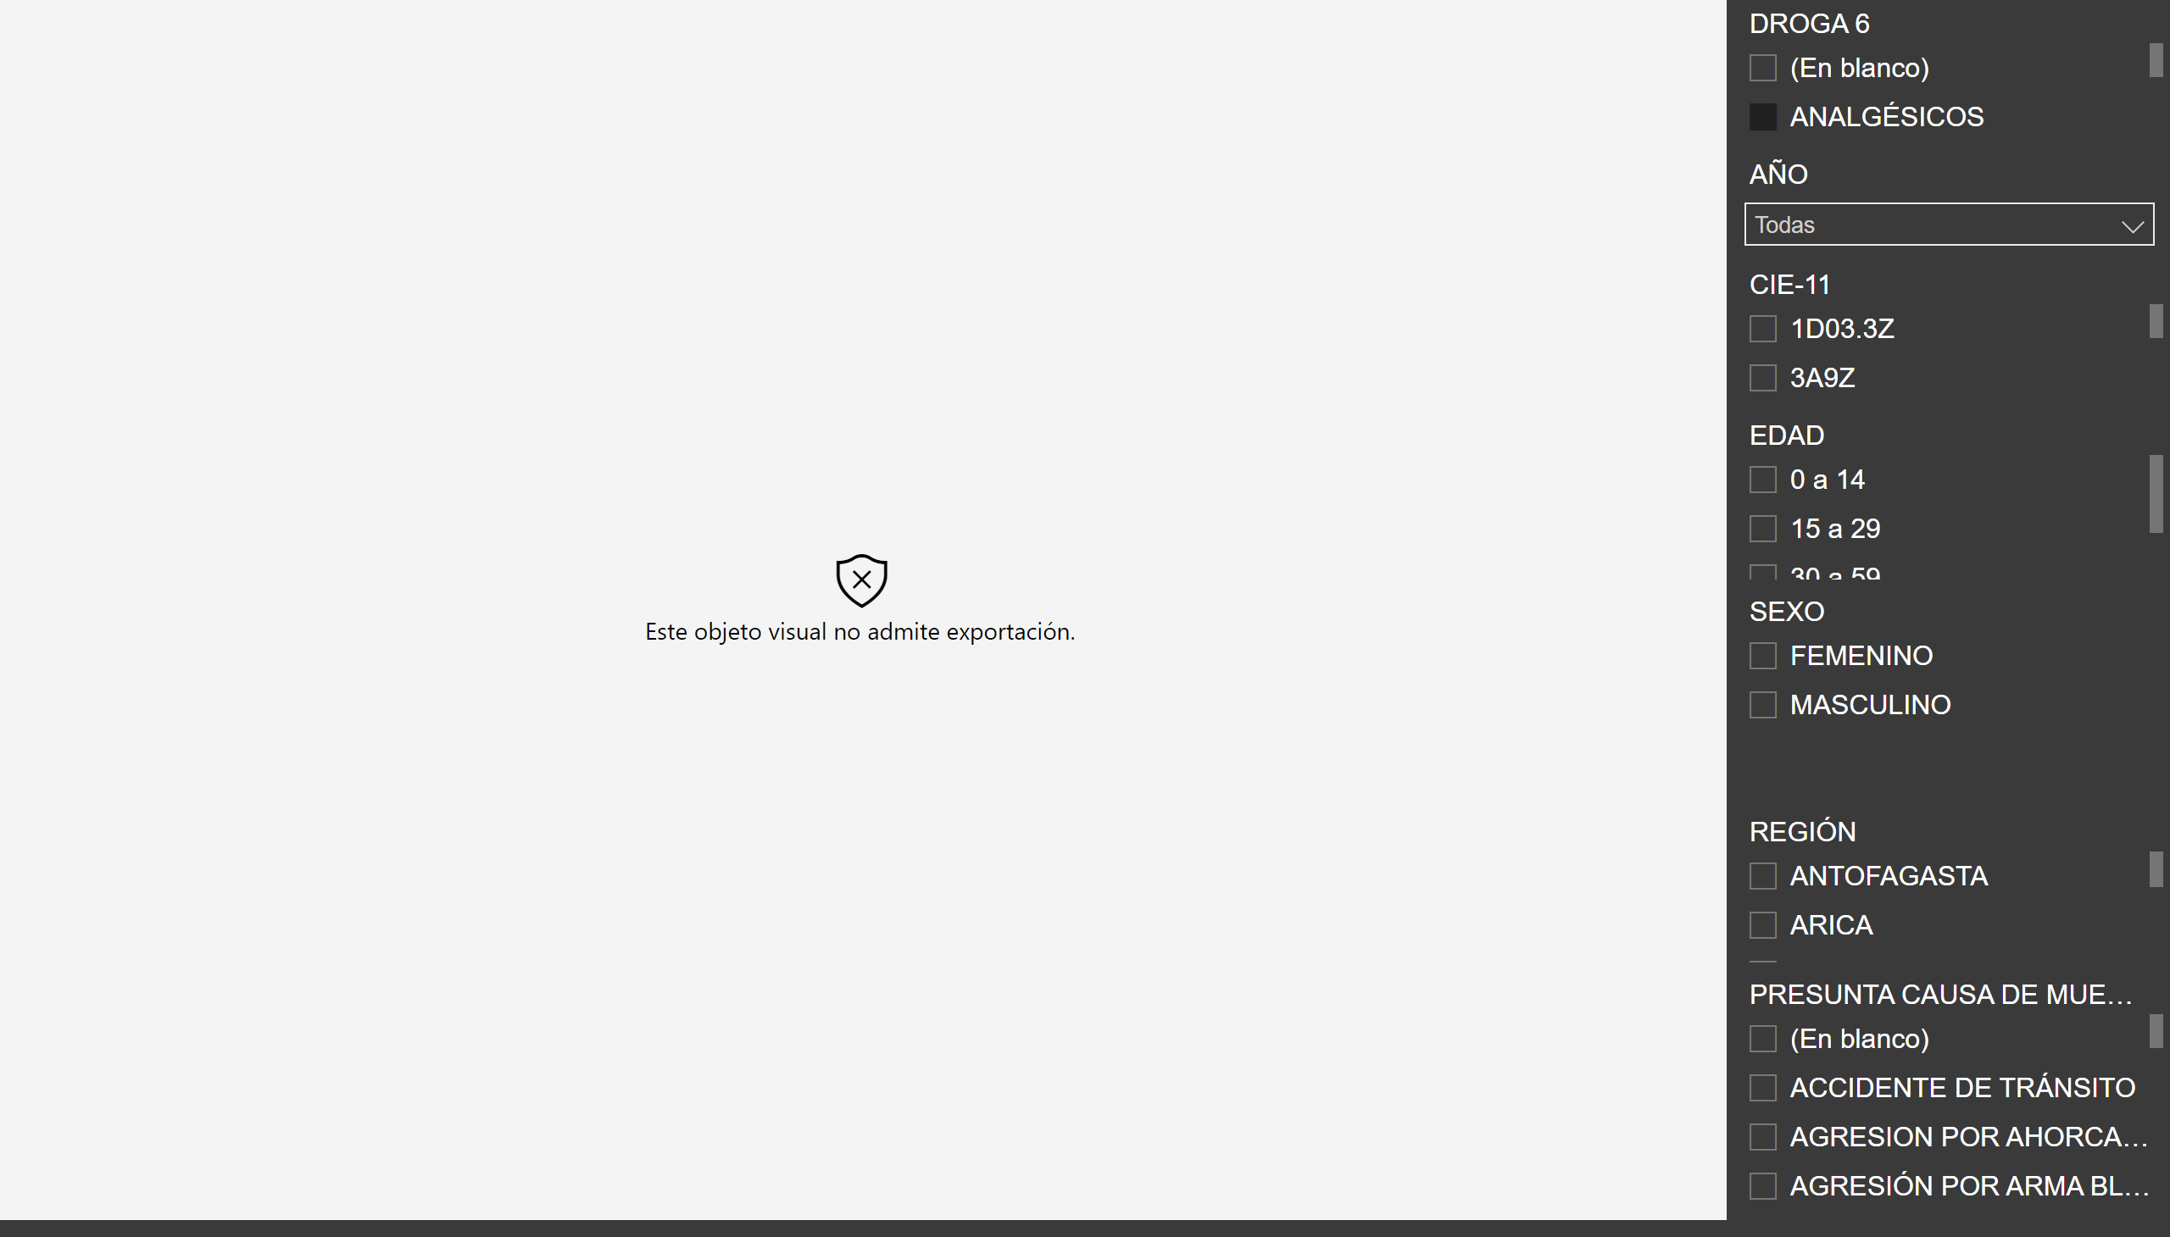
D6
Notes:
wishyoulizationbarchartrace
No alt text provided
slicer
No alt text provided
slicer
No alt text provided
slicer
No alt text provided
slicer
No alt text provided
slicer
No alt text provided
slicer
No alt text provided
slicer
No alt text provided

Slide 12

D7
Notes:
wishyoulizationbarchartrace
No alt text provided
slicer
No alt text provided
slicer
No alt text provided
slicer
No alt text provided
slicer
No alt text provided
slicer
No alt text provided
slicer
No alt text provided
slicer
No alt text provided

Slide 13
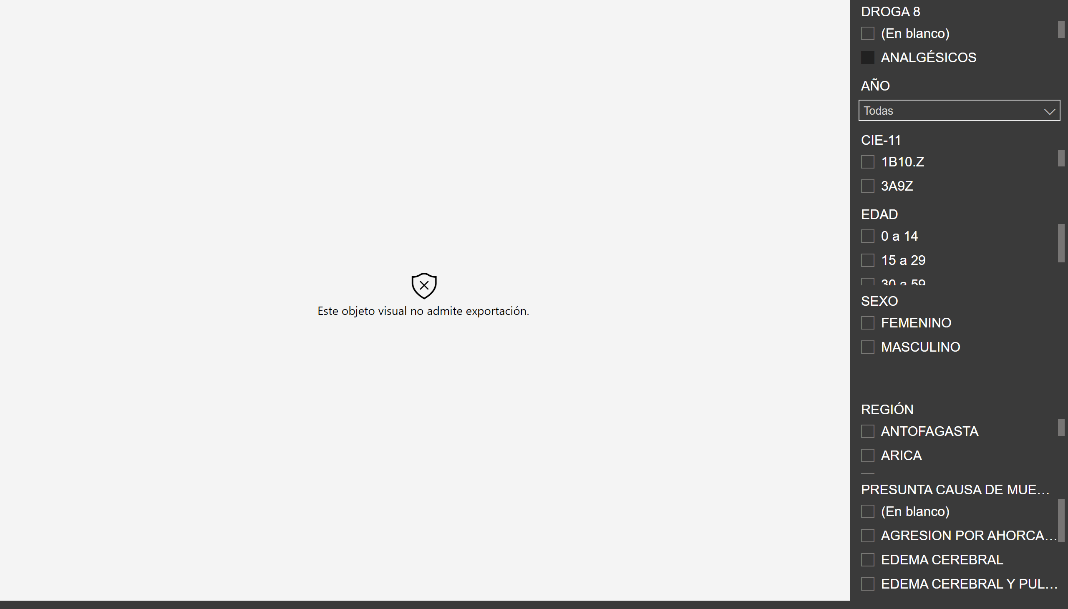
D8
Notes:
wishyoulizationbarchartrace
No alt text provided
slicer
No alt text provided
slicer
No alt text provided
slicer
No alt text provided
slicer
No alt text provided
slicer
No alt text provided
slicer
No alt text provided
slicer
No alt text provided

Slide 14
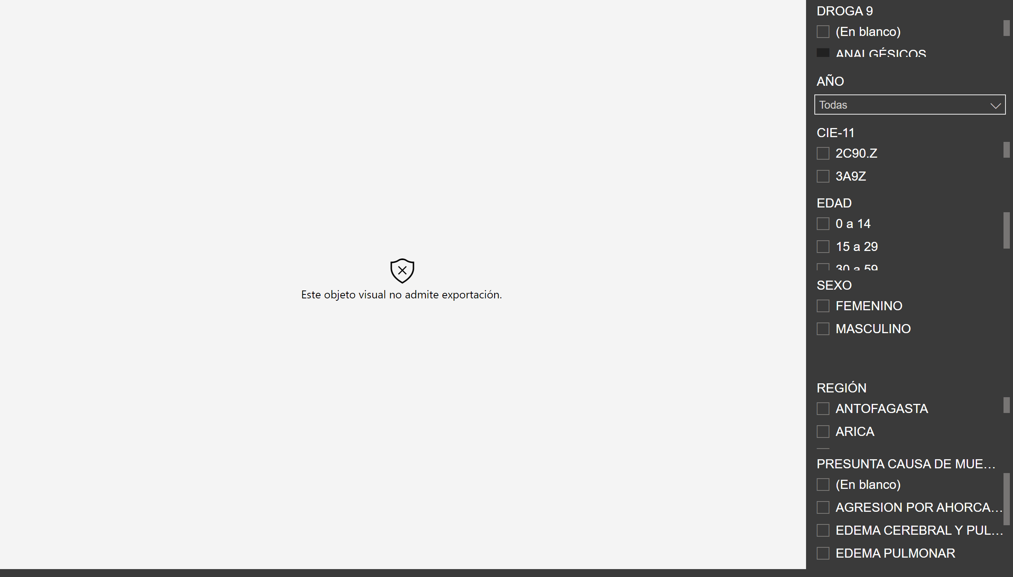
D9
Notes:
wishyoulizationbarchartrace
No alt text provided
slicer
No alt text provided
slicer
No alt text provided
slicer
No alt text provided
slicer
No alt text provided
slicer
No alt text provided
slicer
No alt text provided
slicer
No alt text provided

Slide 15
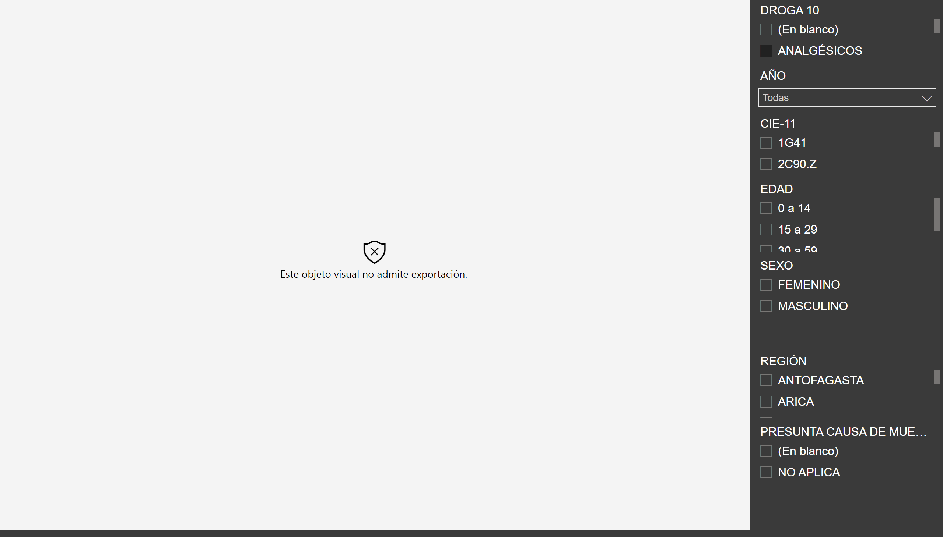
D10
Notes:
wishyoulizationbarchartrace
No alt text provided
slicer
No alt text provided
slicer
No alt text provided
slicer
No alt text provided
slicer
No alt text provided
slicer
No alt text provided
slicer
No alt text provided
slicer
No alt text provided

Slide 16
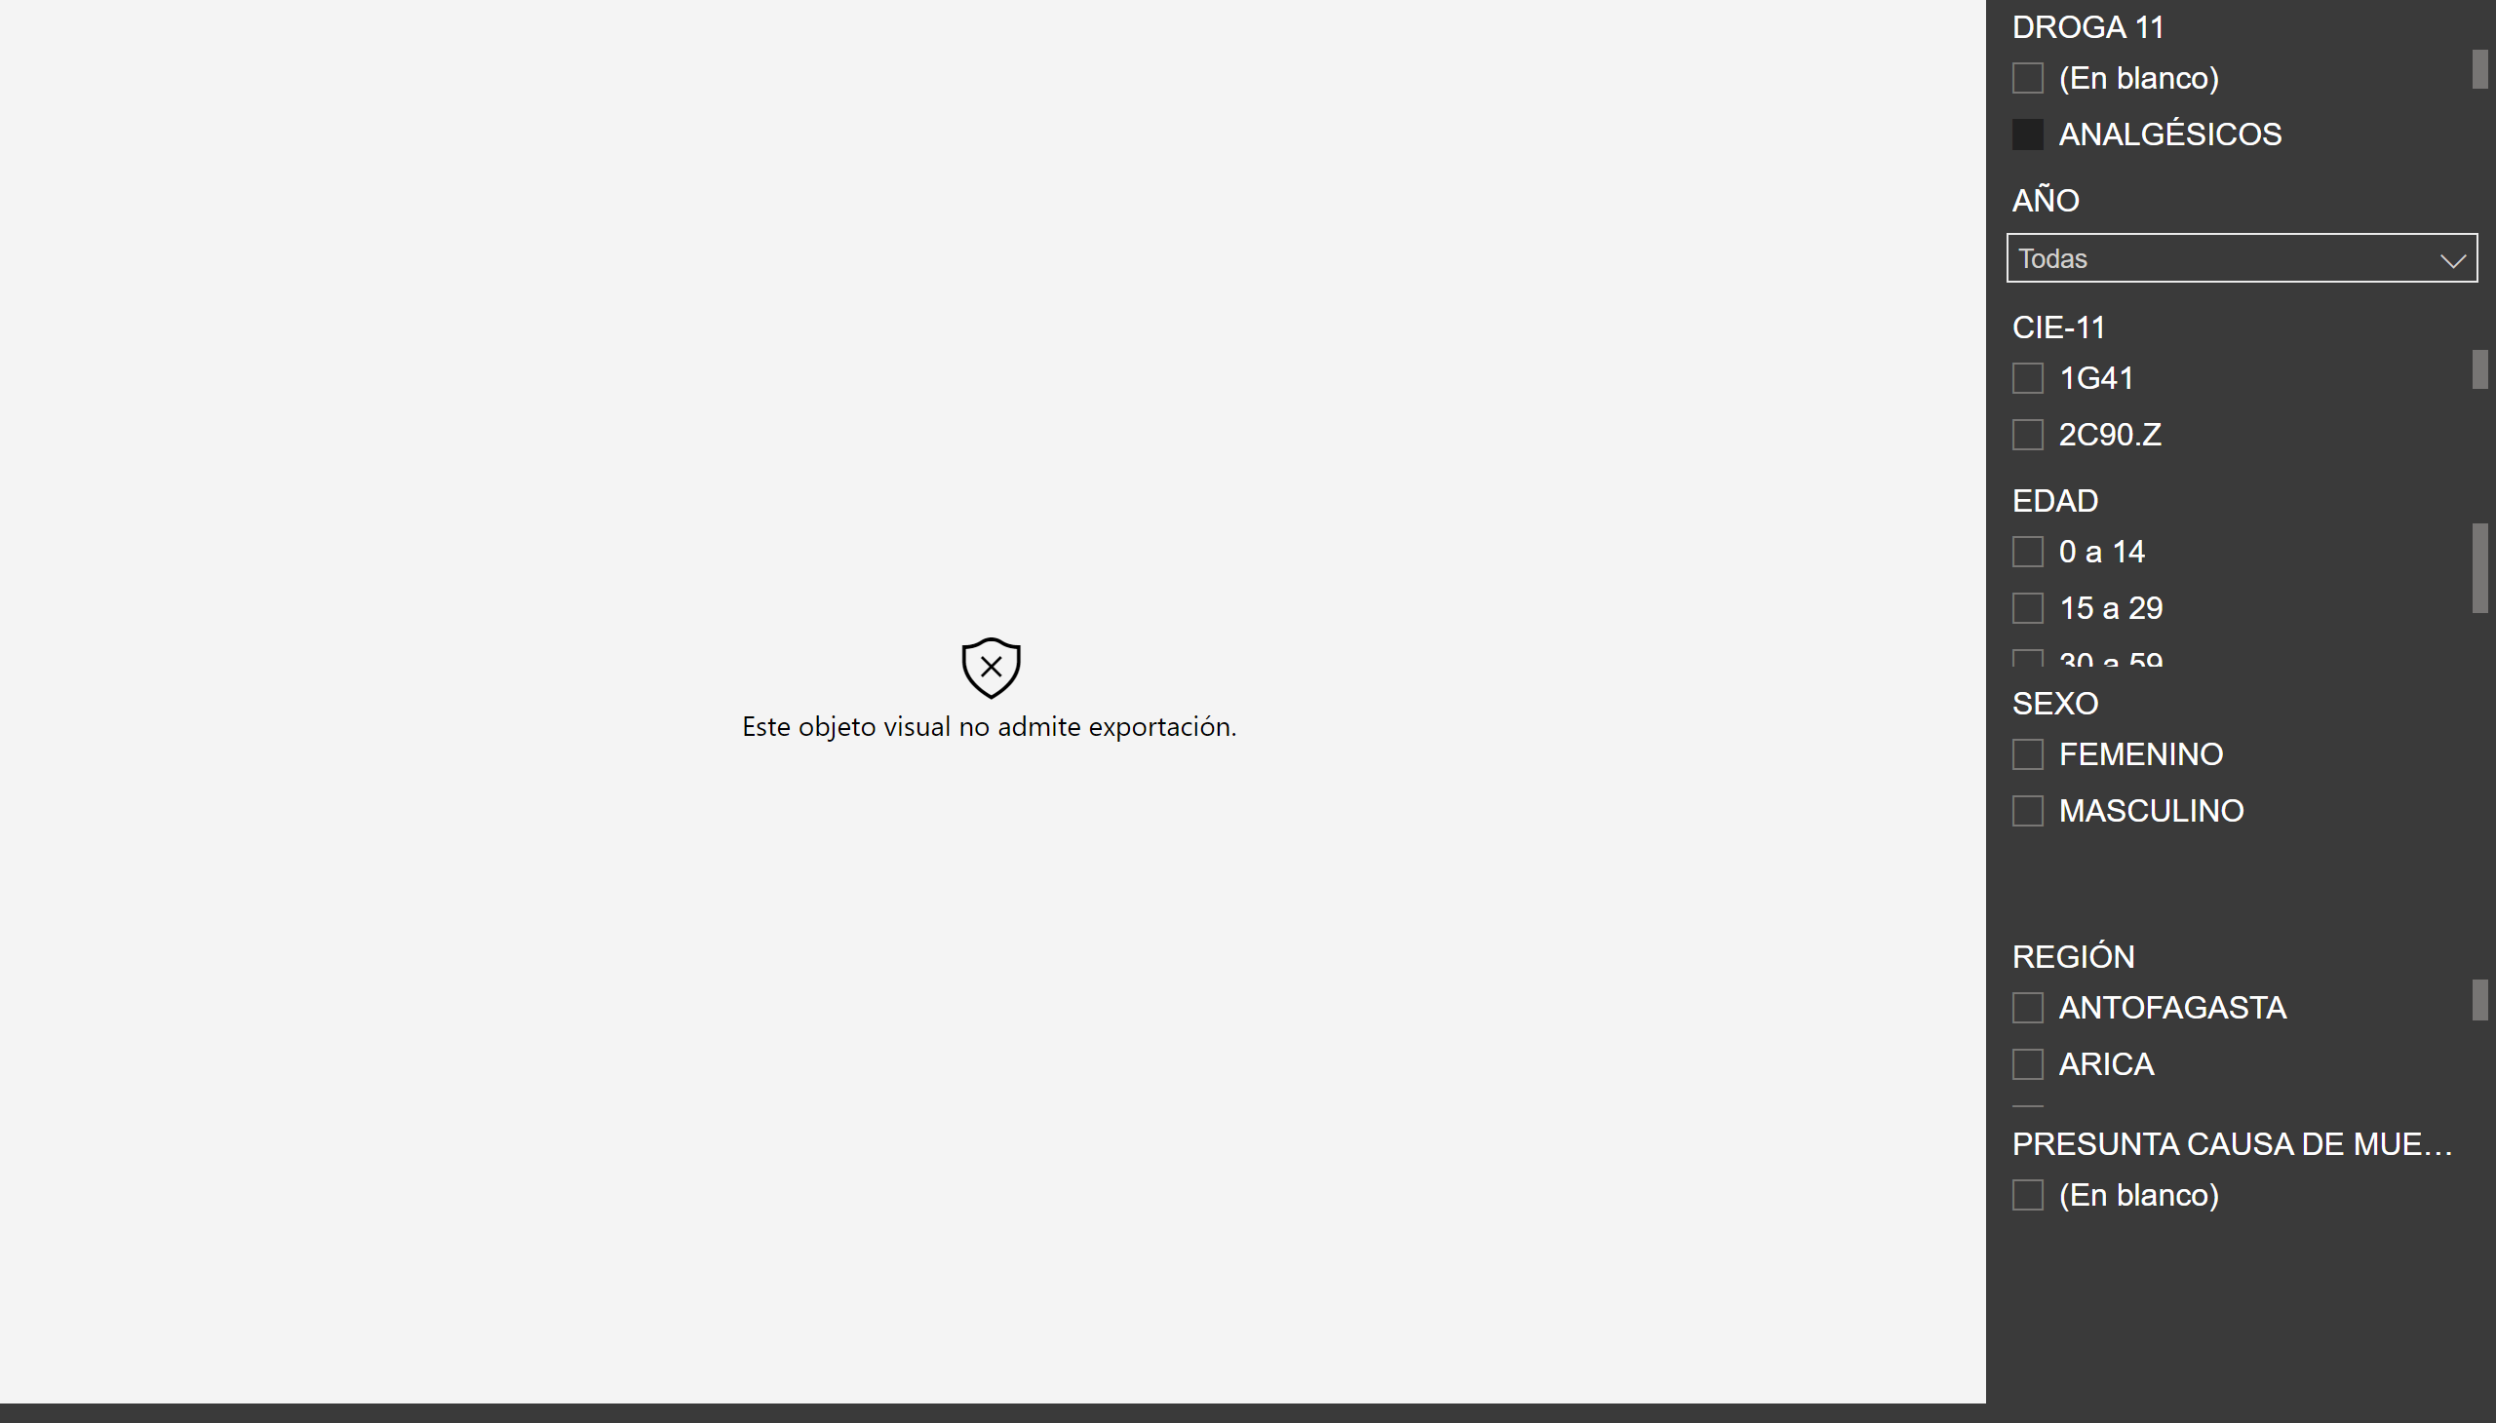
D11
Notes:
wishyoulizationbarchartrace
No alt text provided
slicer
No alt text provided
slicer
No alt text provided
slicer
No alt text provided
slicer
No alt text provided
slicer
No alt text provided
slicer
No alt text provided
slicer
No alt text provided

Slide 17
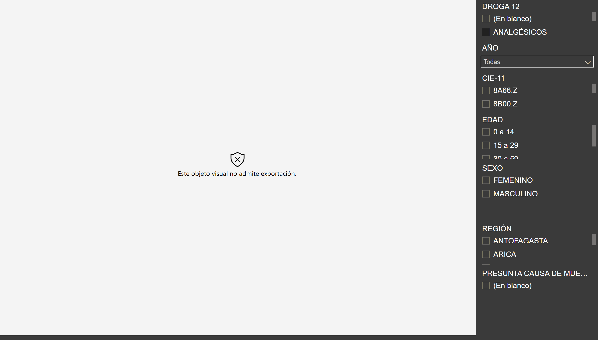
D12
Notes:
wishyoulizationbarchartrace
No alt text provided
slicer
No alt text provided
slicer
No alt text provided
slicer
No alt text provided
slicer
No alt text provided
slicer
No alt text provided
slicer
No alt text provided
slicer
No alt text provided

Slide 18
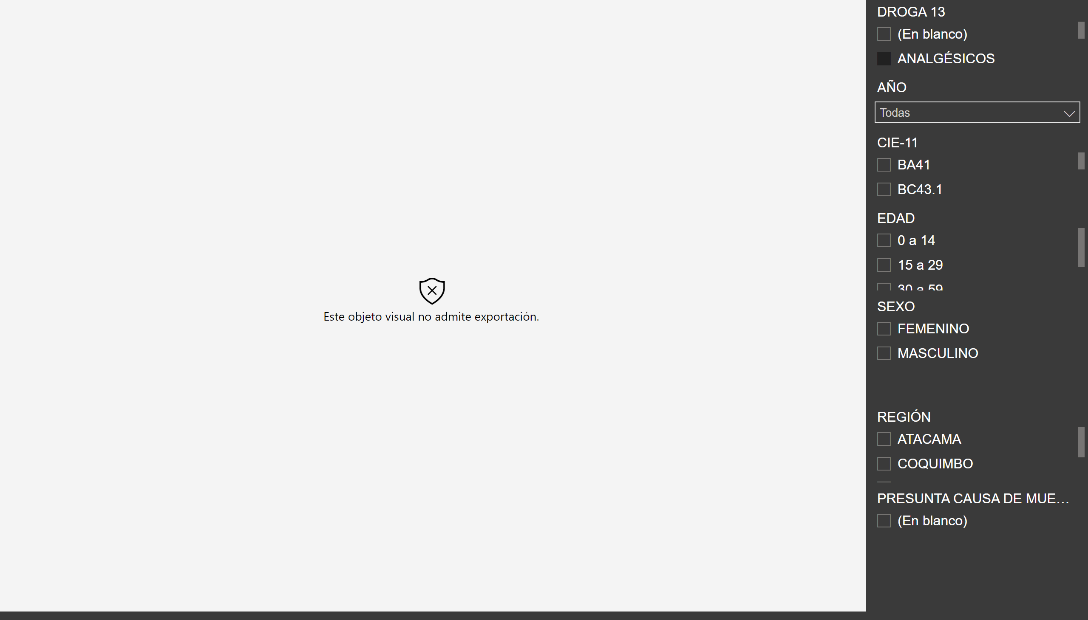
D13
Notes:
wishyoulizationbarchartrace
No alt text provided
slicer
No alt text provided
slicer
No alt text provided
slicer
No alt text provided
slicer
No alt text provided
slicer
No alt text provided
slicer
No alt text provided
slicer
No alt text provided

Slide 19
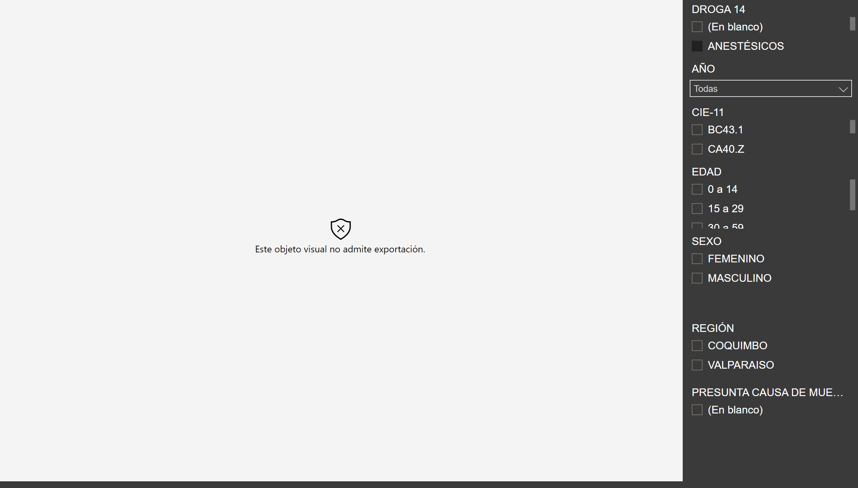
D14
Notes:
wishyoulizationbarchartrace
No alt text provided
slicer
No alt text provided
slicer
No alt text provided
slicer
No alt text provided
slicer
No alt text provided
slicer
No alt text provided
slicer
No alt text provided
slicer
No alt text provided

Slide 20
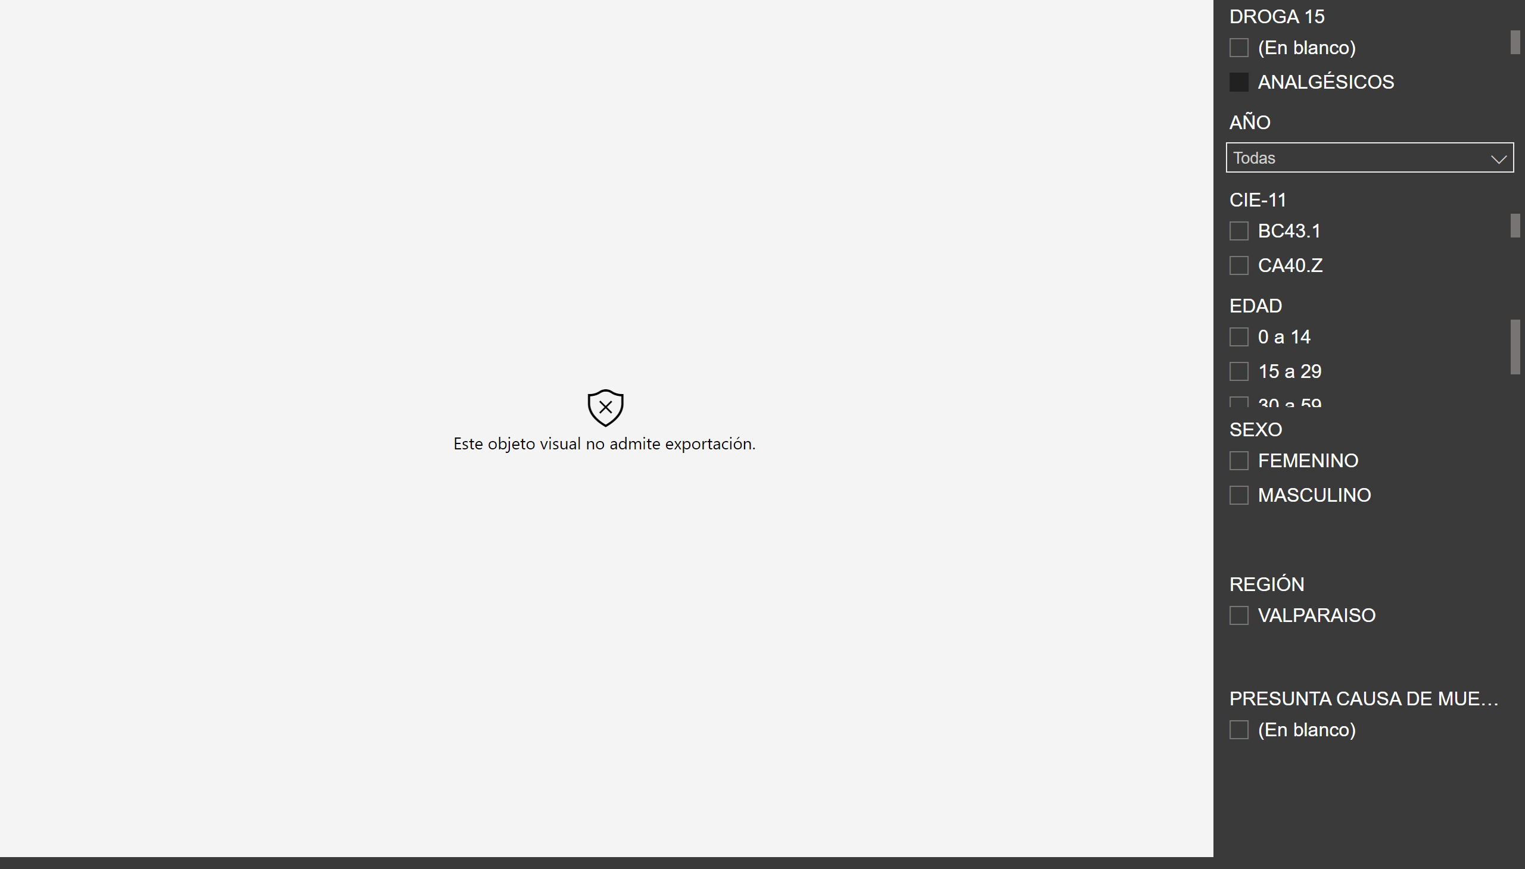
D15
Notes:
wishyoulizationbarchartrace
No alt text provided
slicer
No alt text provided
slicer
No alt text provided
slicer
No alt text provided
slicer
No alt text provided
slicer
No alt text provided
slicer
No alt text provided
slicer
No alt text provided

Slide 21

D16
Notes:
wishyoulizationbarchartrace
No alt text provided
slicer
No alt text provided
slicer
No alt text provided
slicer
No alt text provided
slicer
No alt text provided
slicer
No alt text provided
slicer
No alt text provided
slicer
No alt text provided

Slide 22

D17
Notes:
wishyoulizationbarchartrace
No alt text provided
slicer
No alt text provided
slicer
No alt text provided
slicer
No alt text provided
slicer
No alt text provided
slicer
No alt text provided
slicer
No alt text provided
slicer
No alt text provided

Slide 23

D18
Notes:
wishyoulizationbarchartrace
No alt text provided
slicer
No alt text provided
slicer
No alt text provided
slicer
No alt text provided
slicer
No alt text provided
slicer
No alt text provided
slicer
No alt text provided
slicer
No alt text provided

Slide 24
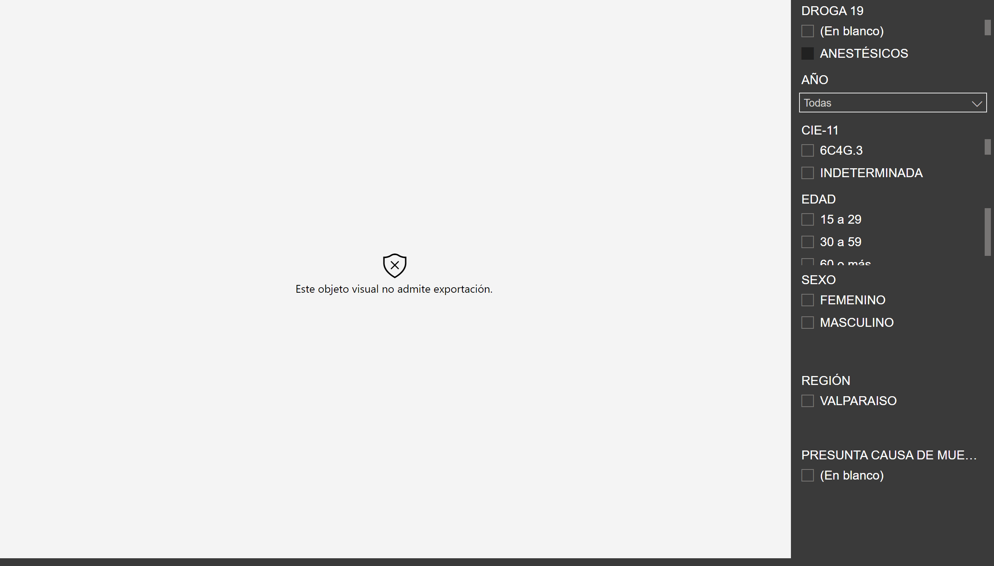
D19
Notes:
wishyoulizationbarchartrace
No alt text provided
slicer
No alt text provided
slicer
No alt text provided
slicer
No alt text provided
slicer
No alt text provided
slicer
No alt text provided
slicer
No alt text provided
slicer
No alt text provided

Slide 25
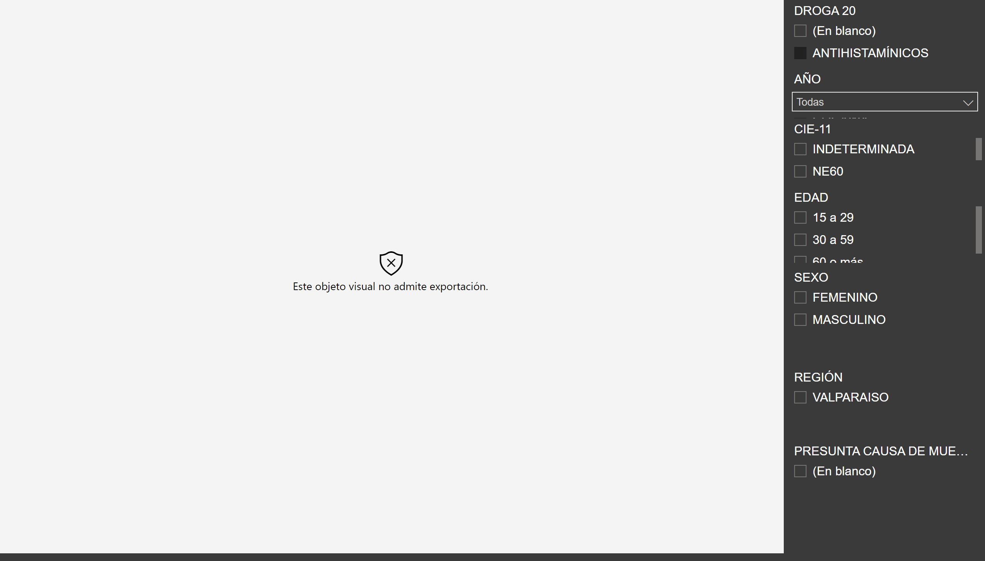
D20
Notes:
wishyoulizationbarchartrace
No alt text provided
slicer
No alt text provided
slicer
No alt text provided
slicer
No alt text provided
slicer
No alt text provided
slicer
No alt text provided
slicer
No alt text provided
slicer
No alt text provided

Slide 26
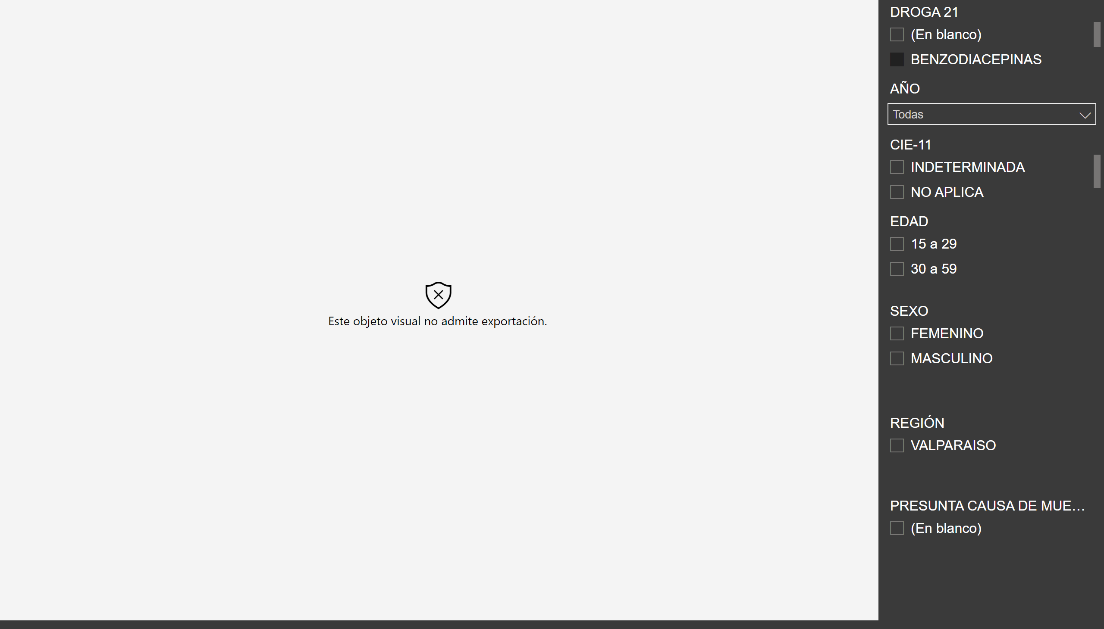
D21
Notes:
wishyoulizationbarchartrace
No alt text provided
slicer
No alt text provided
slicer
No alt text provided
slicer
No alt text provided
slicer
No alt text provided
slicer
No alt text provided
slicer
No alt text provided
slicer
No alt text provided

Slide 27
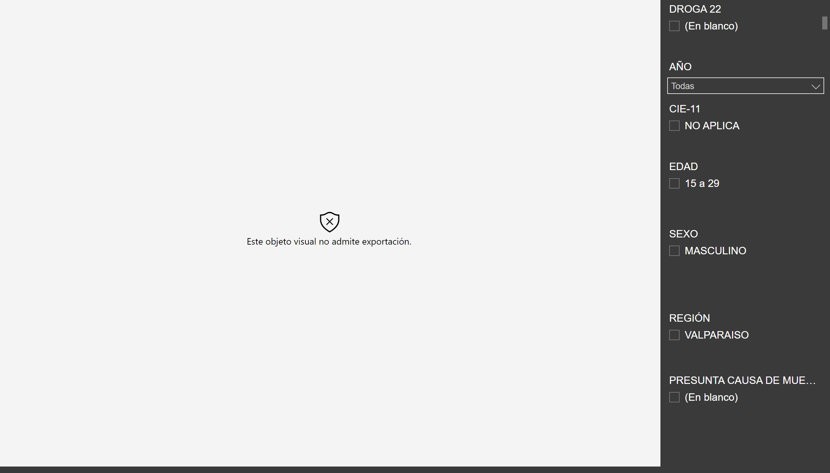
D22
Notes:
wishyoulizationbarchartrace
No alt text provided
slicer
No alt text provided
slicer
No alt text provided
slicer
No alt text provided
slicer
No alt text provided
slicer
No alt text provided
slicer
No alt text provided
slicer
No alt text provided

Slide 28
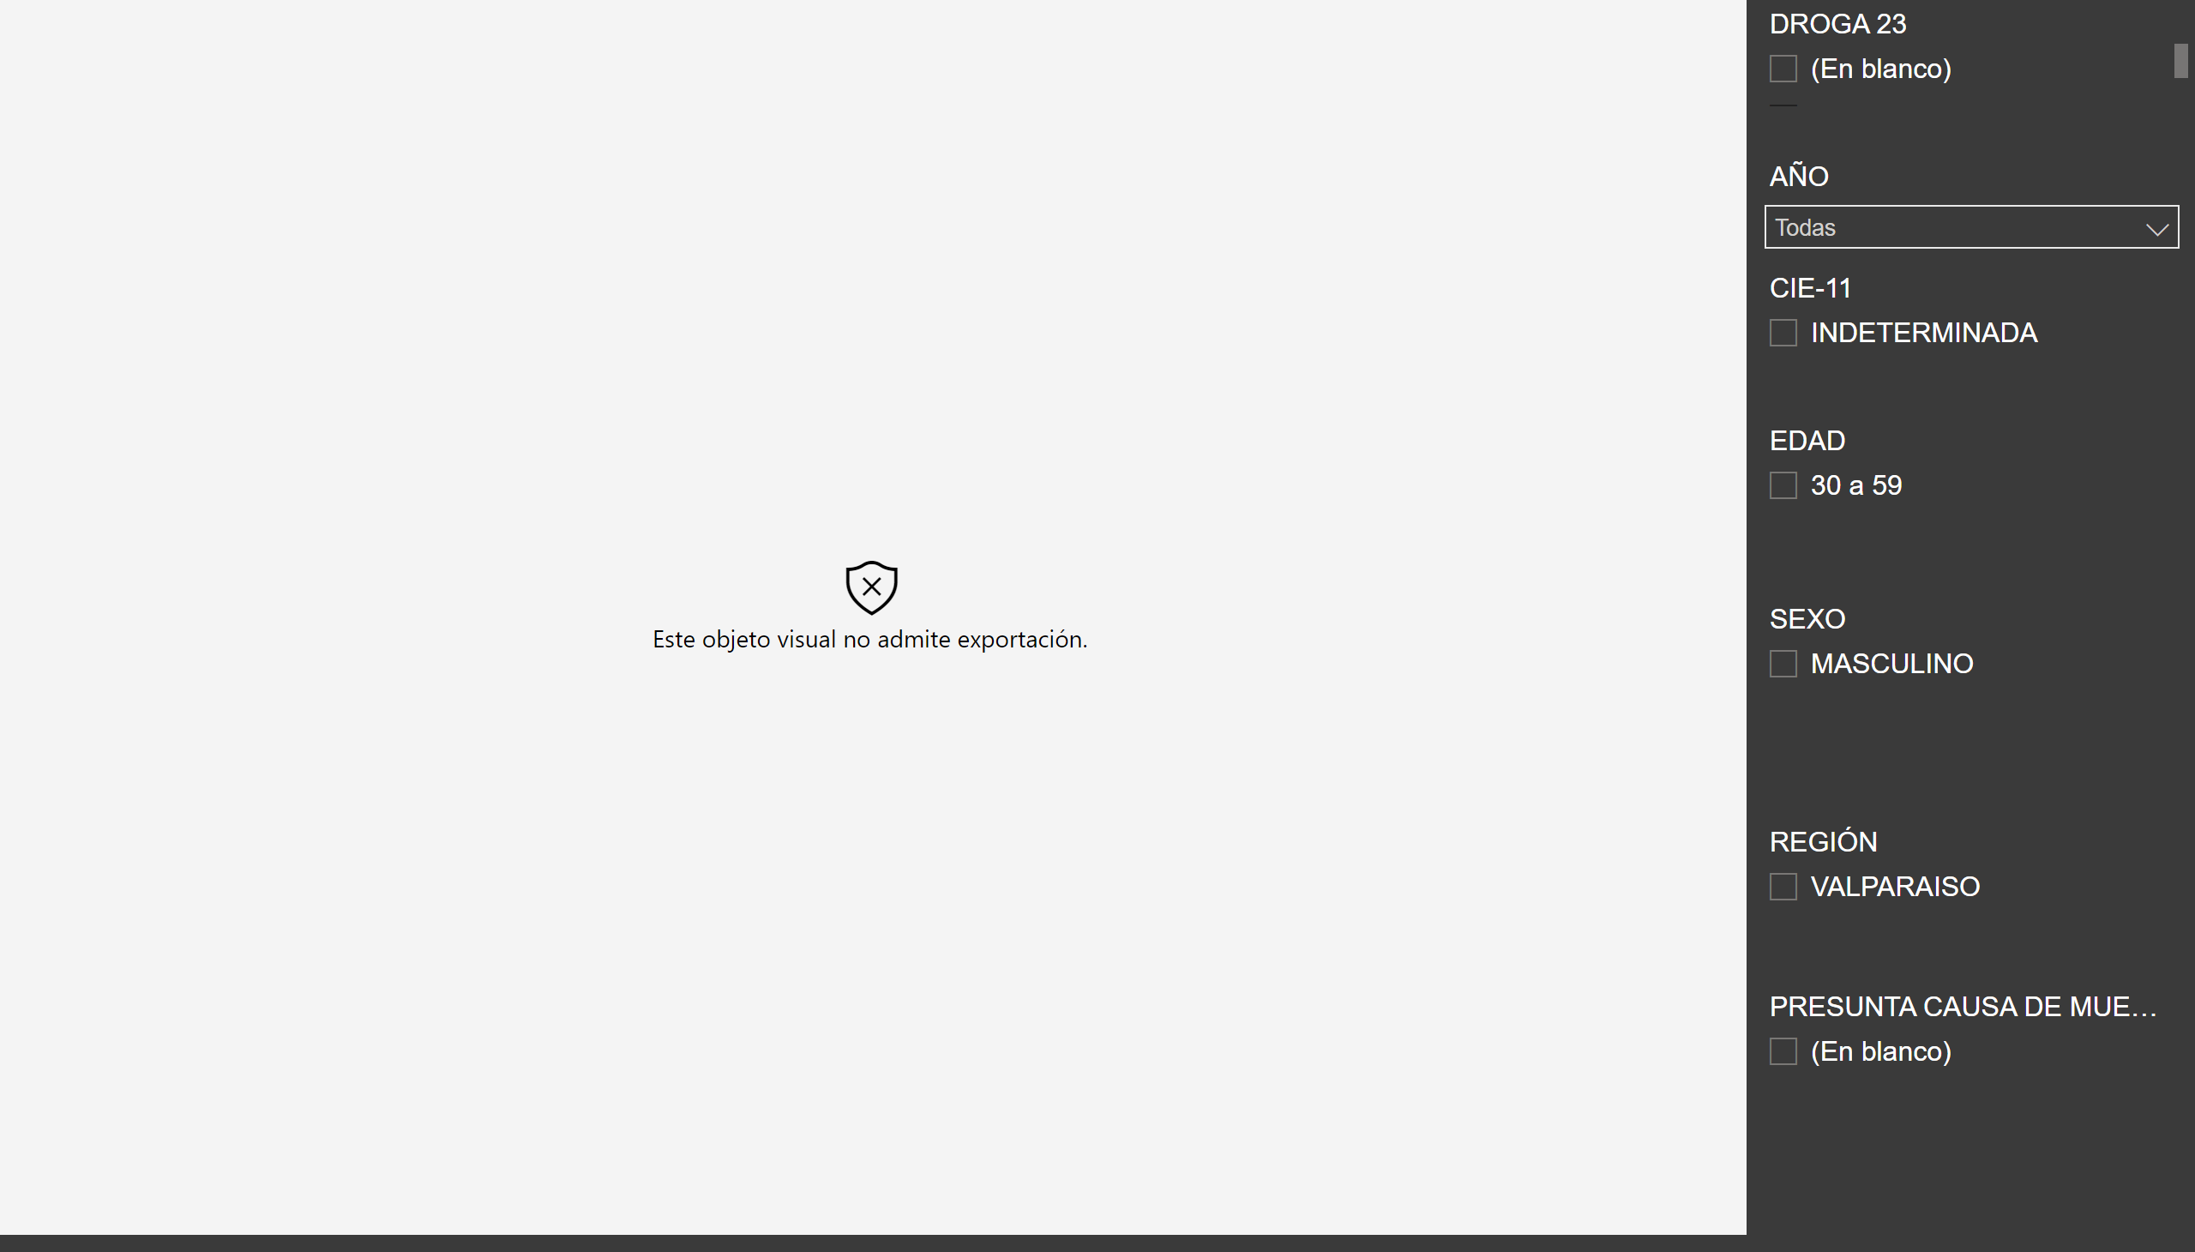
D23
Notes:
wishyoulizationbarchartrace
No alt text provided
slicer
No alt text provided
slicer
No alt text provided
slicer
No alt text provided
slicer
No alt text provided
slicer
No alt text provided
slicer
No alt text provided
slicer
No alt text provided

Slide 29
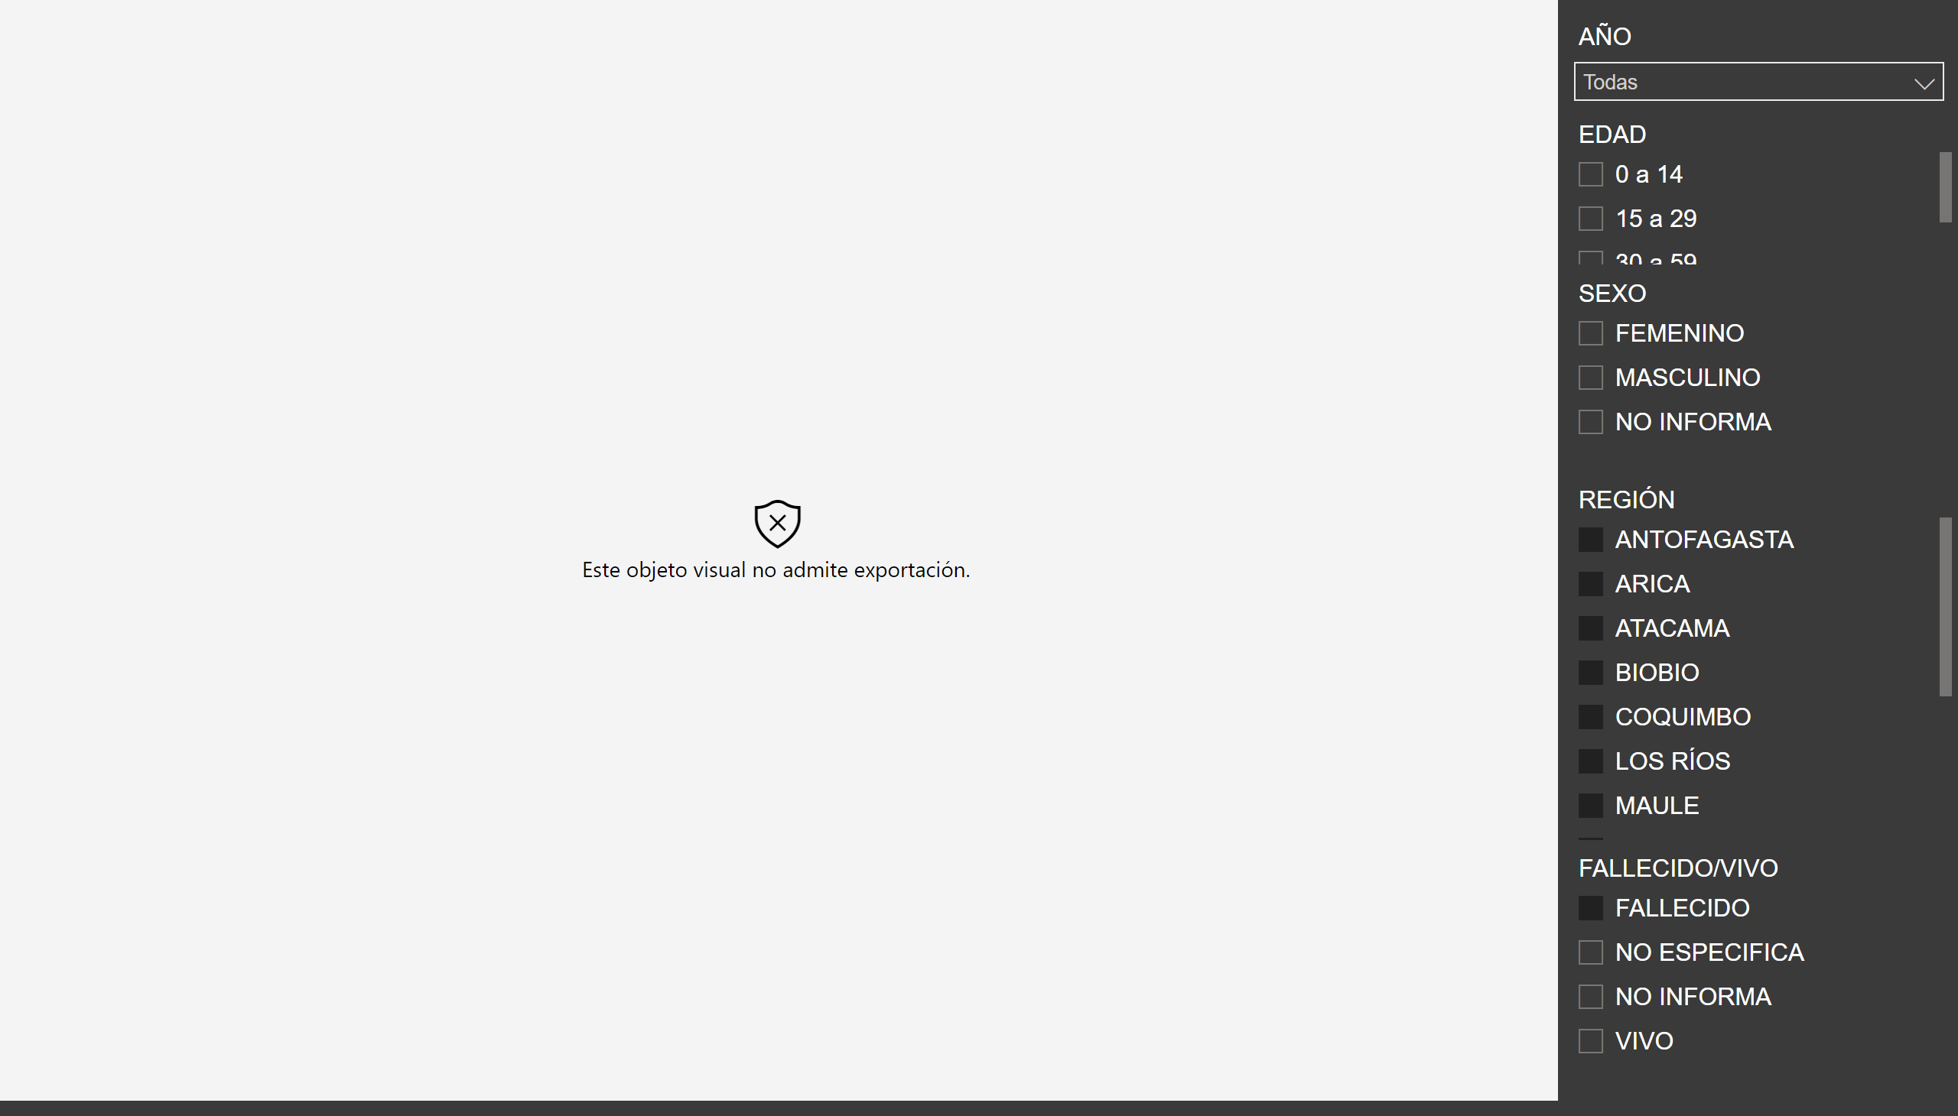
Exploración x Sexo, Región, Año (!)
Notes:
wishyoulizationbarchartrace
No alt text provided
slicer
No alt text provided
slicer
No alt text provided
slicer
No alt text provided
slicer
No alt text provided
slicer
No alt text provided

Slide 30
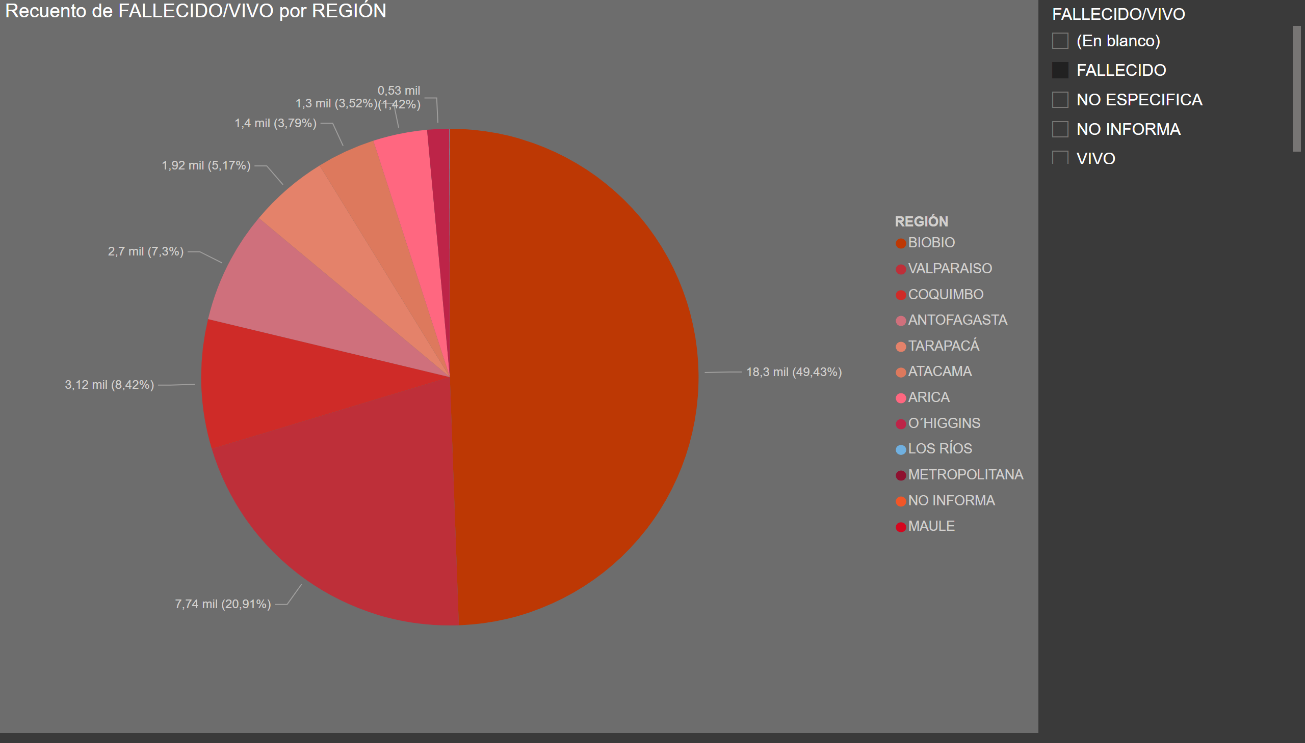
Torta Región Fallecidos (!)
Notes:
pieChart
No alt text provided
slicer
No alt text provided

Slide 31
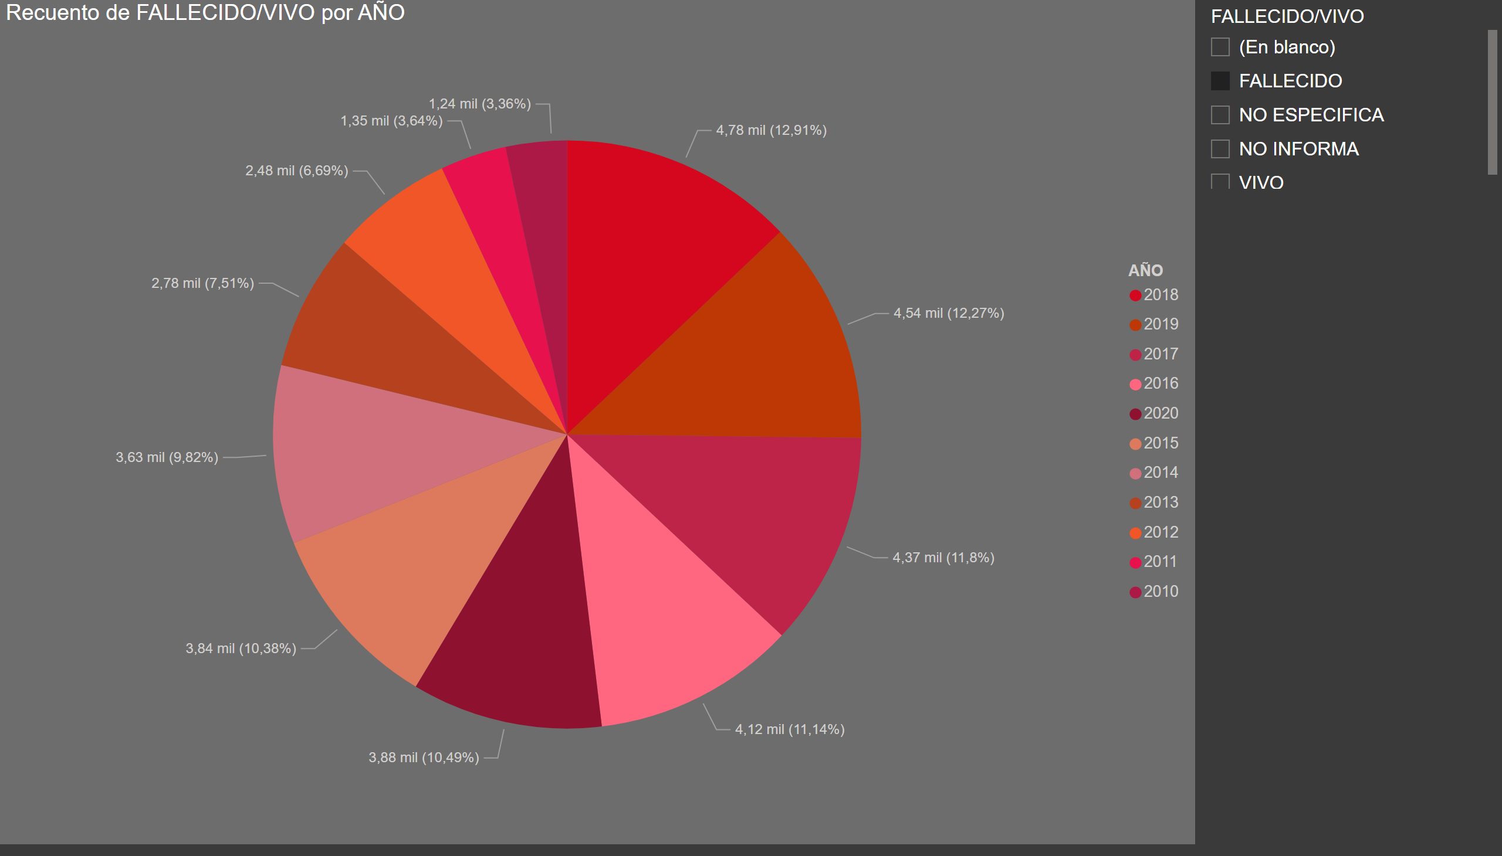
Torta Año Fallecidos (!)
Notes:
pieChart
No alt text provided
slicer
No alt text provided

Slide 32
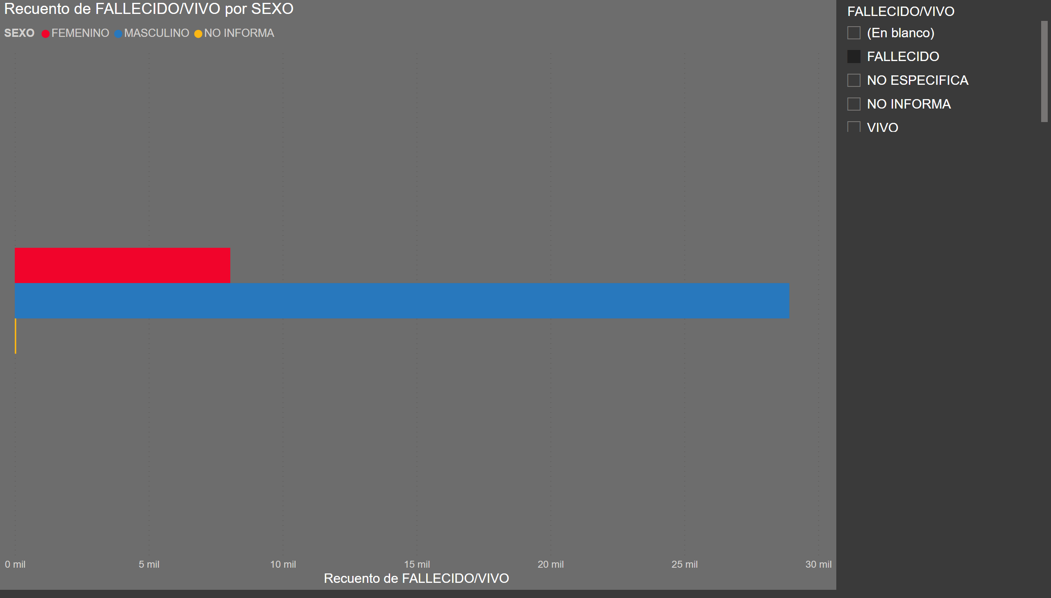
Barras Sexo x Fallecidos (!)
Notes:
clusteredBarChart
No alt text provided
slicer
No alt text provided

Slide 33
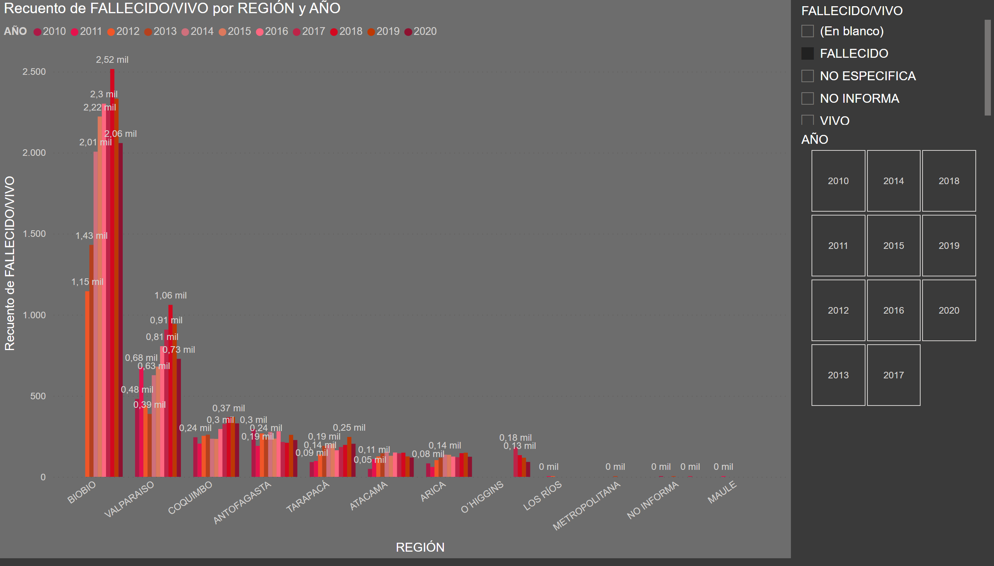
Histograma Región, Año y Fallecidos (!)
Notes:
clusteredColumnChart
No alt text provided
slicer
No alt text provided
slicer
No alt text provided

Slide 34
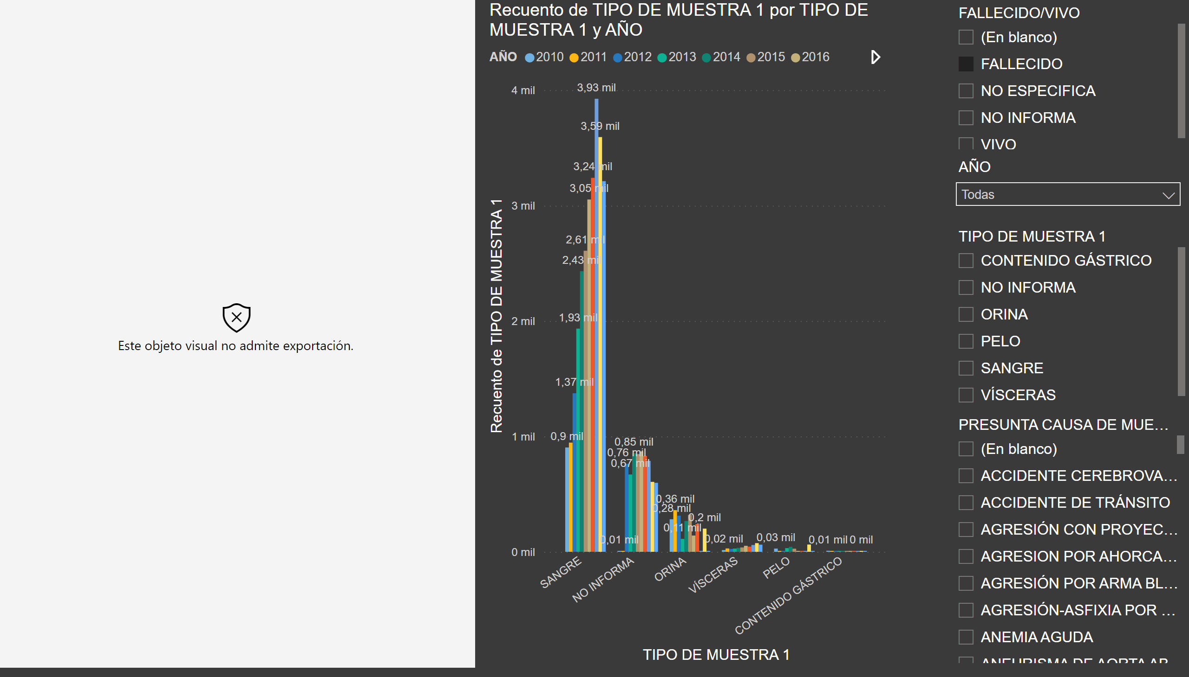
Exploración Analito, Causa de Muerte 1 (!)
Notes:
wishyoulizationbarchartrace
No alt text provided
slicer
No alt text provided
slicer
No alt text provided
clusteredColumnChart
No alt text provided
slicer
No alt text provided
slicer
No alt text provided

Slide 35
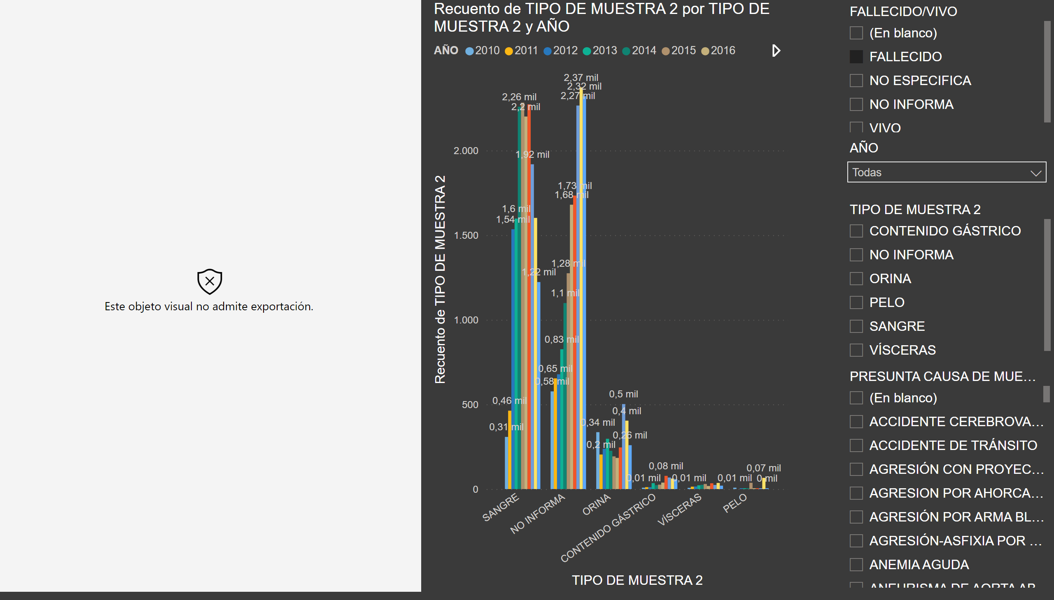
Exploración Analito, Causa de Muerte 2 (!)
Notes:
wishyoulizationbarchartrace
No alt text provided
slicer
No alt text provided
slicer
No alt text provided
clusteredColumnChart
No alt text provided
slicer
No alt text provided
slicer
No alt text provided

Slide 36
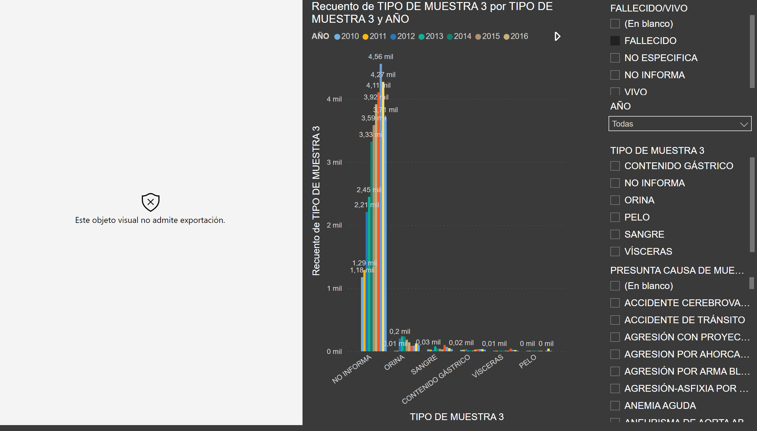
Exploración Analito, Causa de Muerte 3 (!)
Notes:
wishyoulizationbarchartrace
No alt text provided
slicer
No alt text provided
slicer
No alt text provided
clusteredColumnChart
No alt text provided
slicer
No alt text provided
slicer
No alt text provided

Slide 37
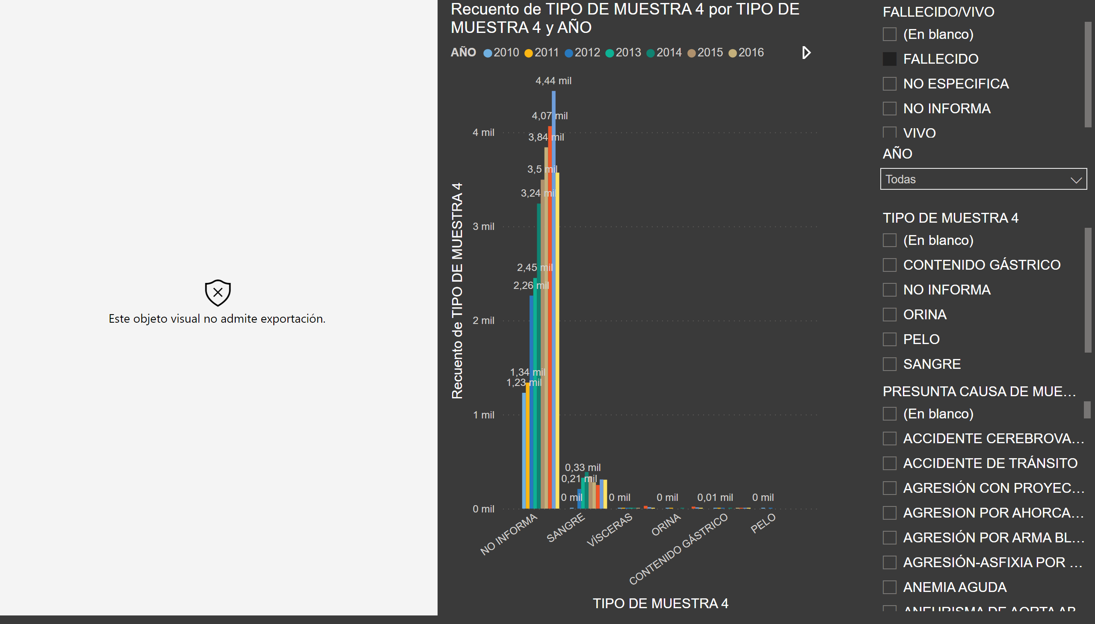
Exploración Analito, Causa de Muerte 4 (!)
Notes:
wishyoulizationbarchartrace
No alt text provided
slicer
No alt text provided
slicer
No alt text provided
clusteredColumnChart
No alt text provided
slicer
No alt text provided
slicer
No alt text provided

Slide 38
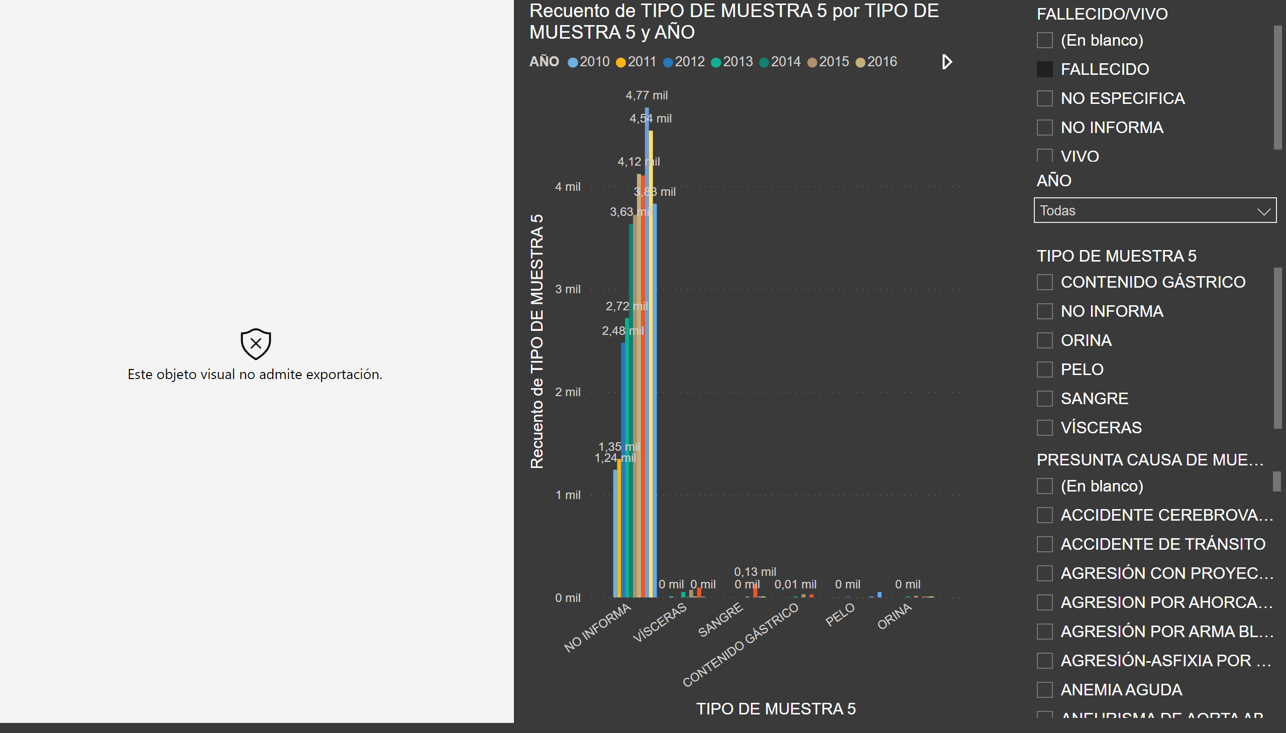
Exploración Analito, Causa de Muerte 5 (!)
Notes:
wishyoulizationbarchartrace
No alt text provided
slicer
No alt text provided
slicer
No alt text provided
clusteredColumnChart
No alt text provided
slicer
No alt text provided
slicer
No alt text provided

Slide 39
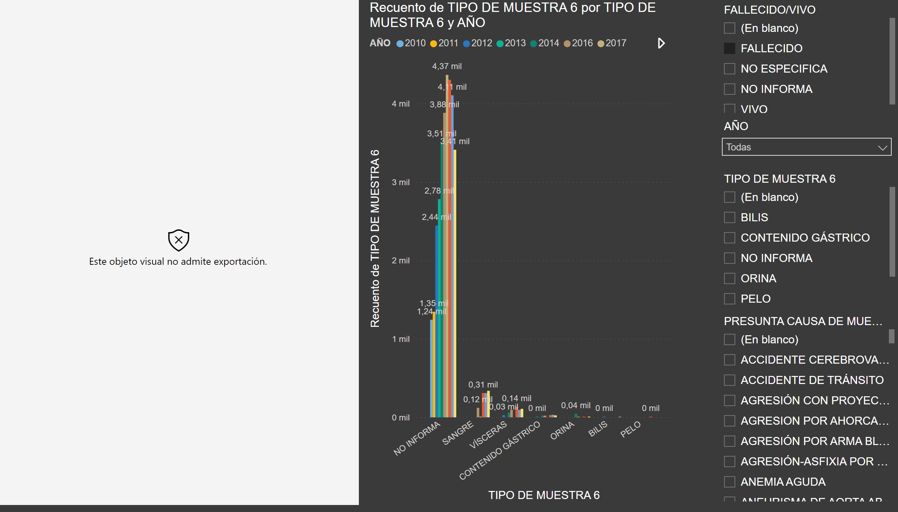
Exploración Analito, Causa de Muerte 6 (!)
Notes:
wishyoulizationbarchartrace
No alt text provided
slicer
No alt text provided
slicer
No alt text provided
clusteredColumnChart
No alt text provided
slicer
No alt text provided
slicer
No alt text provided

Slide 40
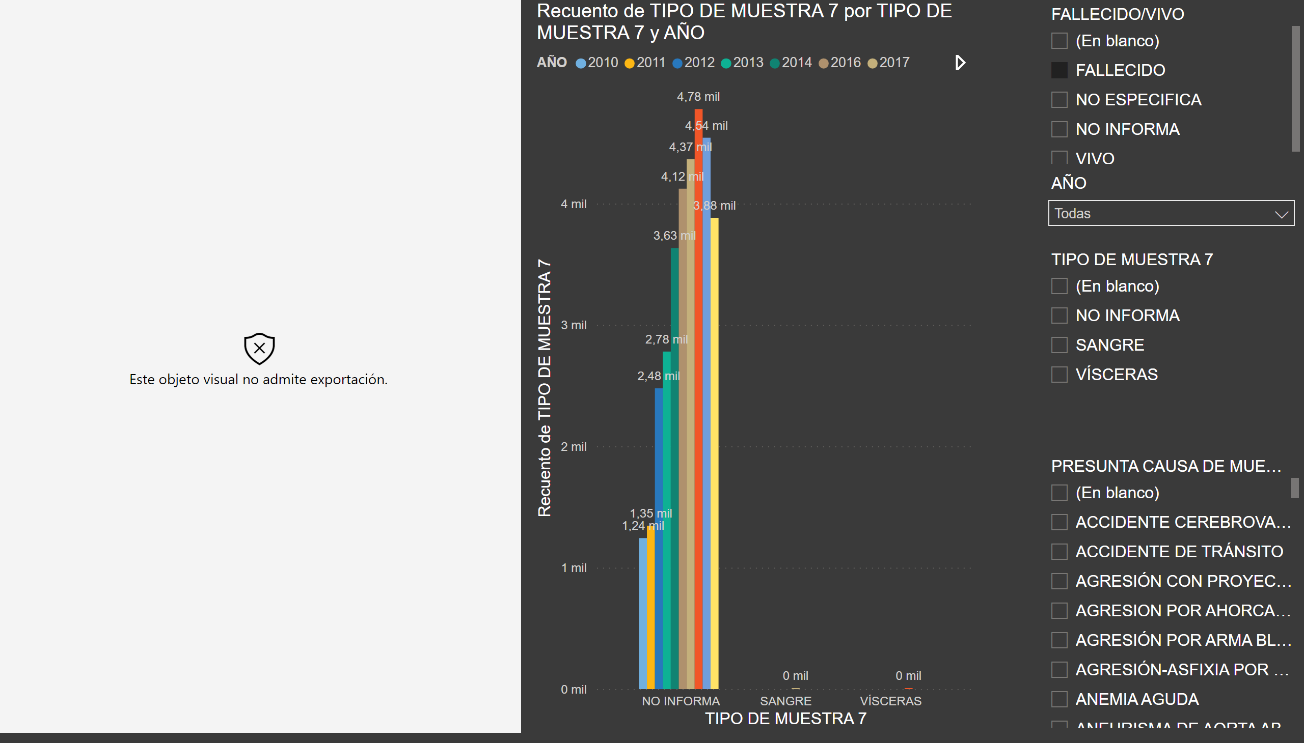
Exploración Analito, Causa de Muerte 7 (!)
Notes:
wishyoulizationbarchartrace
No alt text provided
slicer
No alt text provided
slicer
No alt text provided
clusteredColumnChart
No alt text provided
slicer
No alt text provided
slicer
No alt text provided

Slide 41
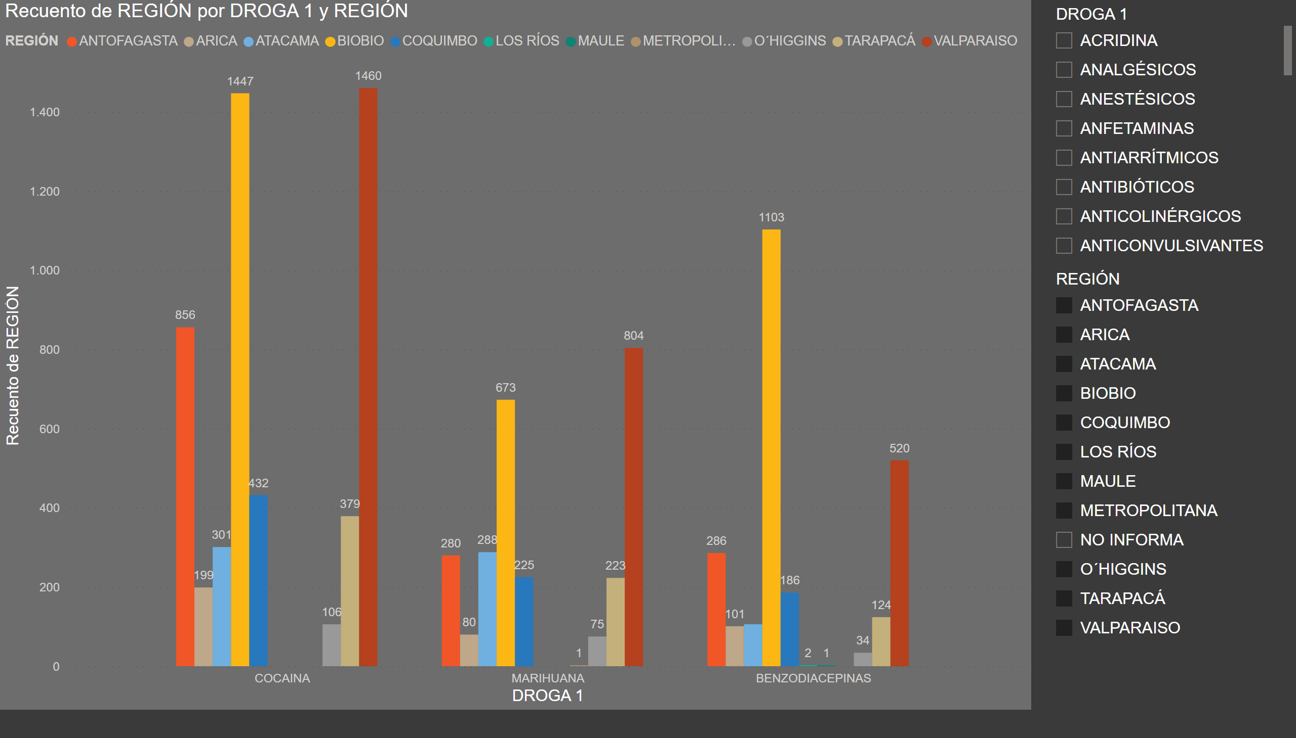
Visualización Drogas x Región Top 3 (!)
Notes:
clusteredColumnChart
No alt text provided
slicer
No alt text provided
slicer
No alt text provided

Slide 42
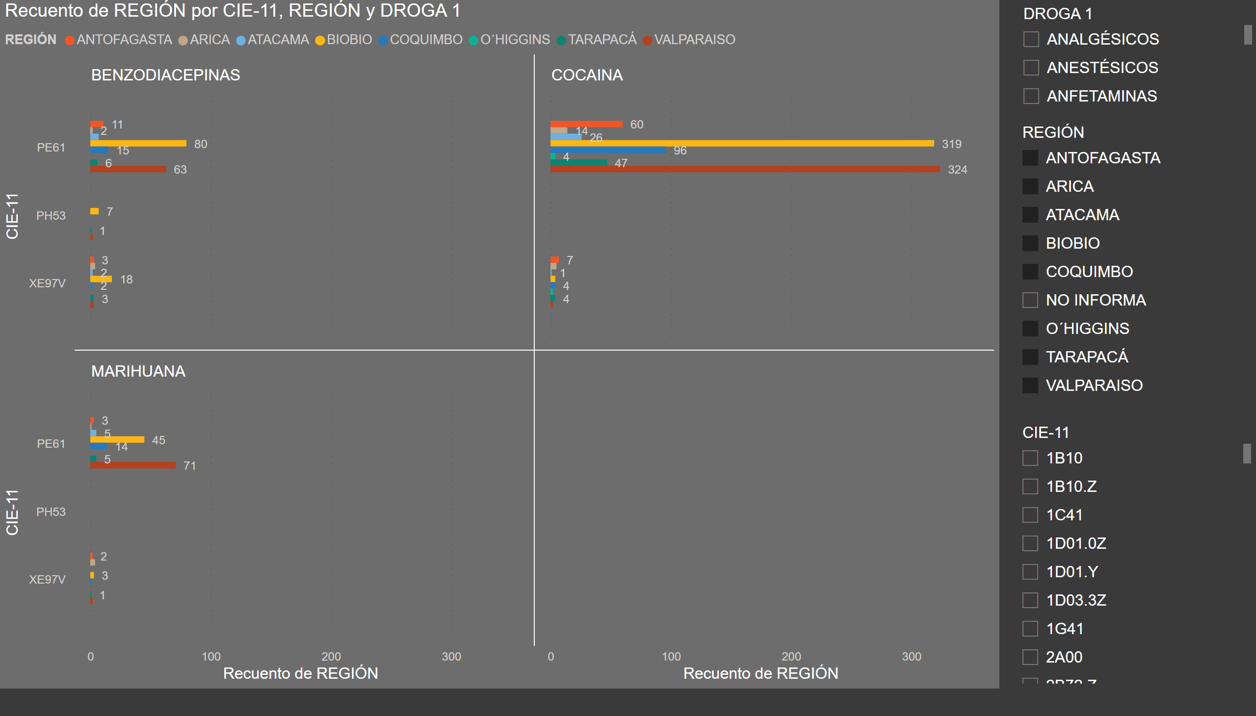
Visualización Causa de Muerte Top 3 (!)
Notes:
clusteredBarChart
No alt text provided
slicer
No alt text provided
slicer
No alt text provided
slicer
No alt text provided

